Slide 1
Scopus & SciVal for researchers Help make stay up to date with your field and learn how to use Elsevier’s Scopus and SciVal tools for scholarly purposes
Dr Matt Walker
29th November 2017

Slide 2
Getting published: very high attrition at the first hurdle!
Elsevier receives c.1.5M submissions p.a.. Roughly 35% of all submitted manuscripts are rejected before peer review!
Suggested checklist for authors prior to submission:
Do your findings advance understanding in a specific research field?
Is your work of interest to the journal’s audience?
Is your manuscript structured properly?
Are your conclusions justified by your results?
Are your references international/accessible enough?
Did you format your figures and tables properly?
Did you correct all grammatical and spelling mistakes?
See https://www.elsevier.com/__data/assets/pdf_file/0003/91038/Get-Published-Quick-Guide.pdf for more tips

Slide 3
Key resources I’ll be using today that may help
Scopus (University subscription, Registration advised)
www.scopus.com
SciVal (University subscription, Registration required)
www.scival.com
Mendeley (Free, Registration required)
www.mendeley.com

Slide 4
Agenda
A brief introduction to Scopus & its coverage
How to stay up to date in your field, how to personalize Scopus and set alerts to save you time finding relevant information
Advanced search tips for in-depth literature searches, how to analyse and export information, and create lists
How to view citation trends for a set of documents, find all publications citing a specific document (or set of documents) and discover the overall impact of publications in a research area
Author Profiles and ORCID. Why this is important to check your Author profile and how to use author search find future collaborators / competitors on your topic
Creating Research Areas in SciVal to explore topics and identify key authors and institutions
Looking for new collaborators and potential competitors in SciVal Collaboration module
Benchmarking yourself against others for grant applications and promotion panels

Slide 5
1. A brief introduction to Scopus & its coverage

Slide 6
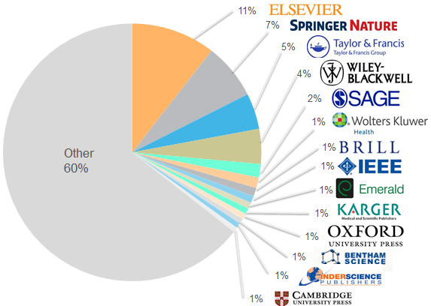
The largest abstract and citation database of research information, launched in 2004
>69M records and 21,912 active titles from more than 5k international publishers. More than 3,780 Gold Open Access journals indexed, 120k books and 7.3M conference proceedings
Our independent and expert Content Selection & Advisory Board (CSAB) use strict criteria to vet the sources that Scopus
Used for THE World University Rankings (from ‘15) and data partner for QS

Slide 7
Further Information on Scopus & current coverage
Scopus blog: http://blog.scopus.com/
Journal & Books title list:
https://www.elsevier.com/solutions/scopus/content
Brighttalk Scopus webinars:
https://www.brighttalk.com/channel/13703/scopus

Slide 8
2. How to stay up to date in your field, how to personalize Scopus & set alerts to save you time finding relevant information

Slide 9
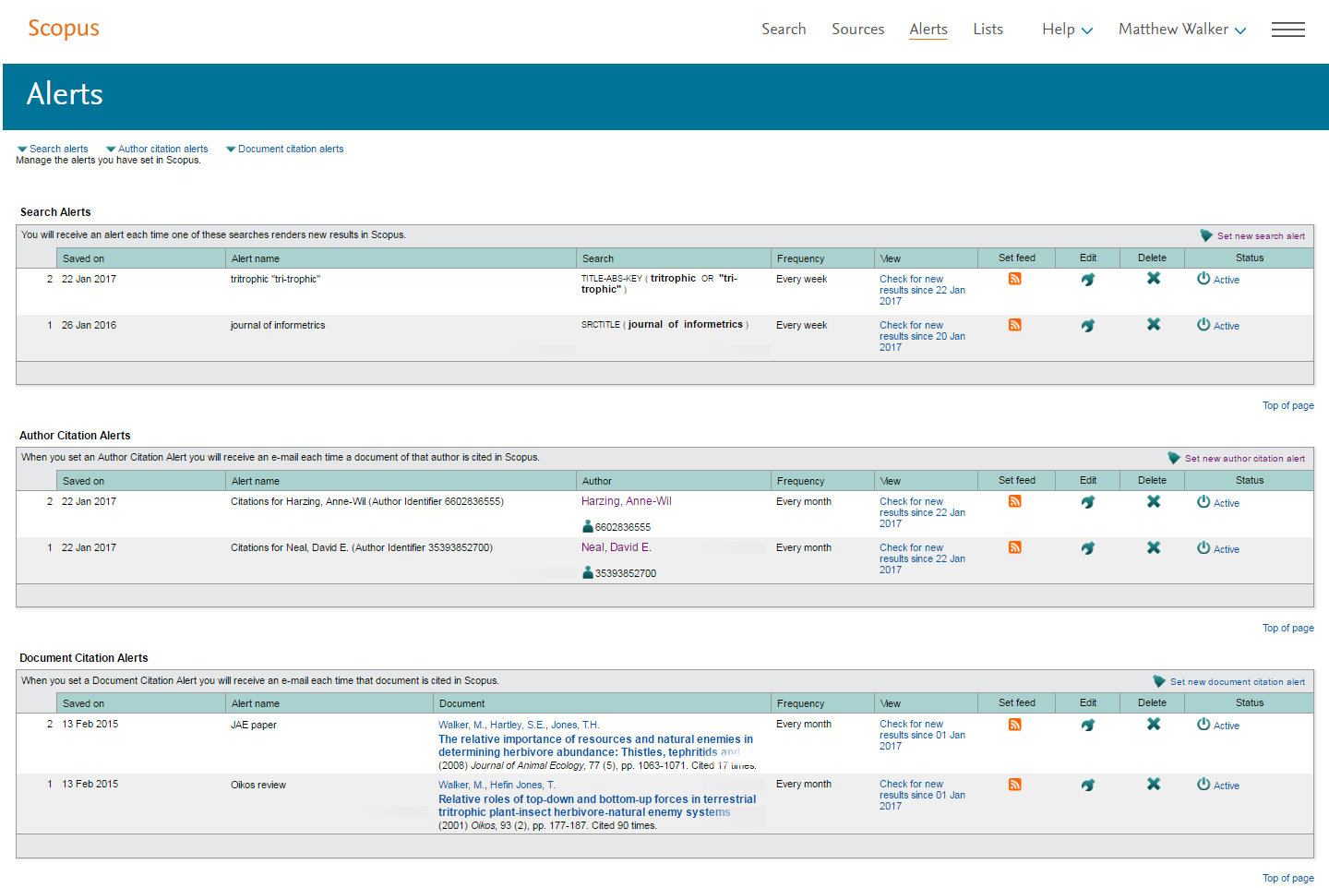
Search, Author Citation and Document Citation alerts

Slide 10
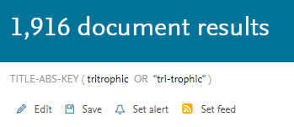
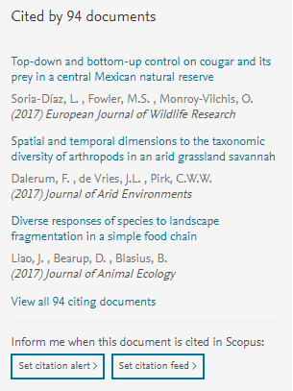
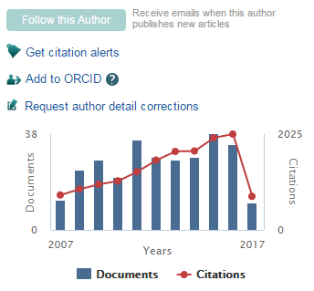
Personalisation is only available if you register & login!

Slide 11
3. Advanced search tips for in-depth literature searches, how to analyse and export information, and create lists

Slide 12
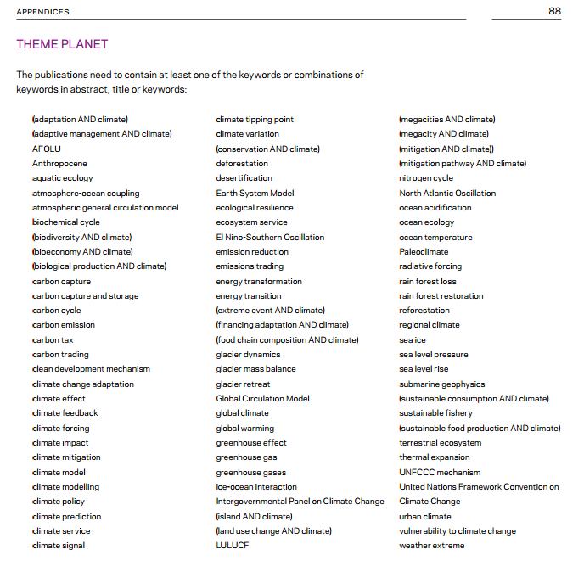
Using Scopus for more detailed analyses
From https://www.elsevier.com/__data/assets/pdf_file/0018/119061/SustainabilityScienceReport-Web.pdf

Slide 13
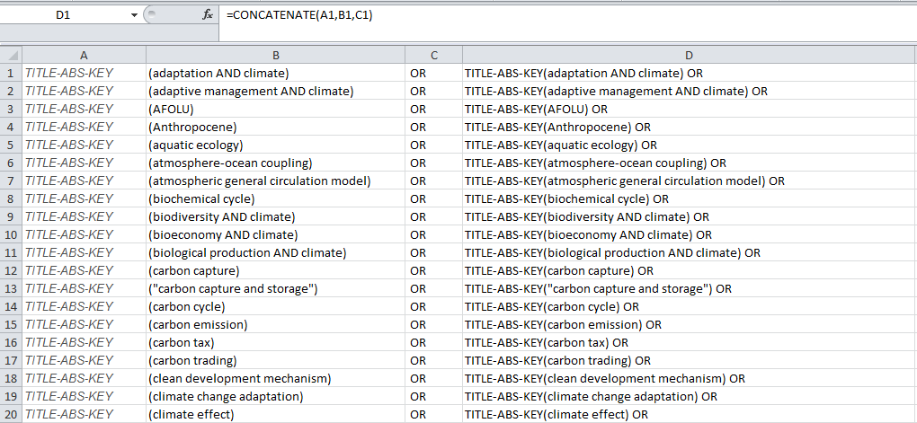
Tip: use Concatenate formula in create search strings

Slide 14
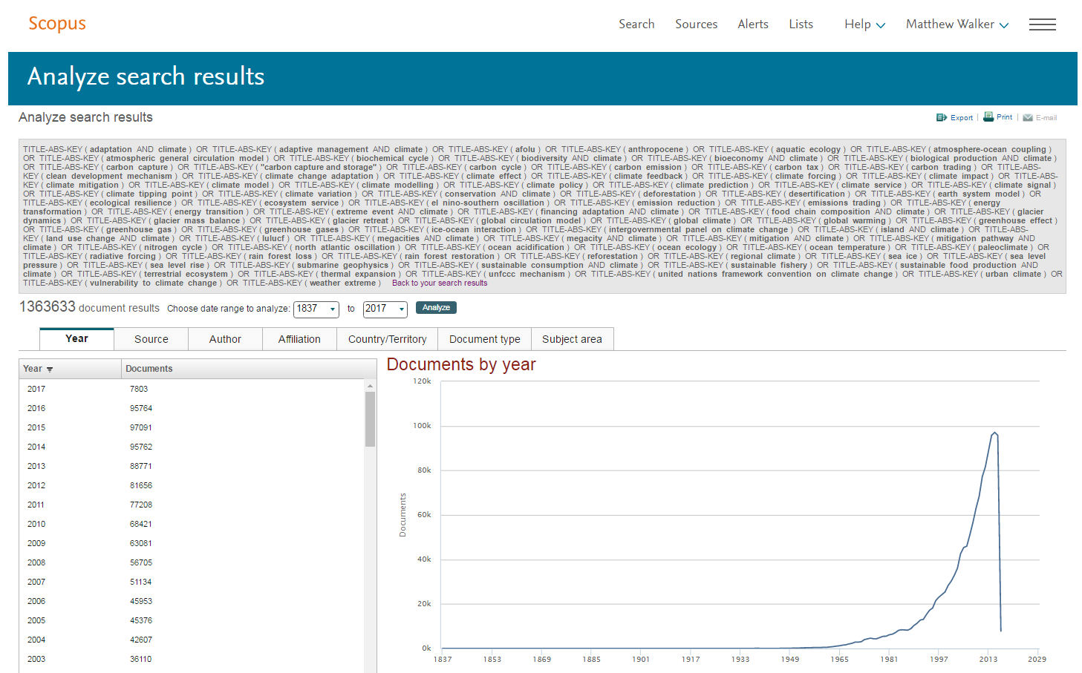
Sample search string in Scopus

Slide 15
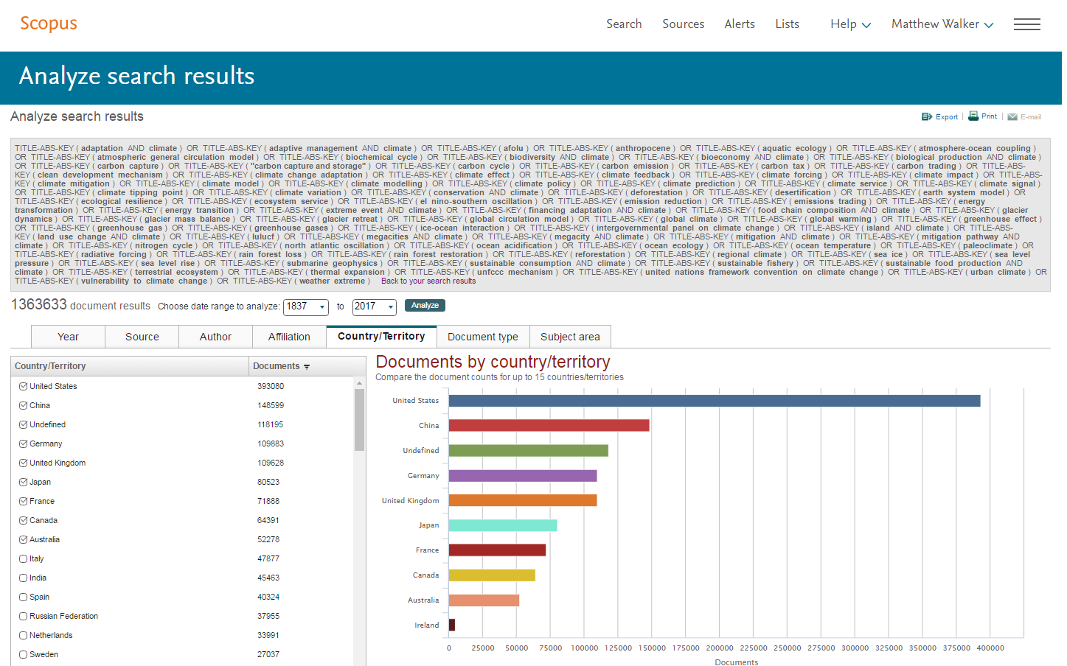
Most active countries

Slide 16
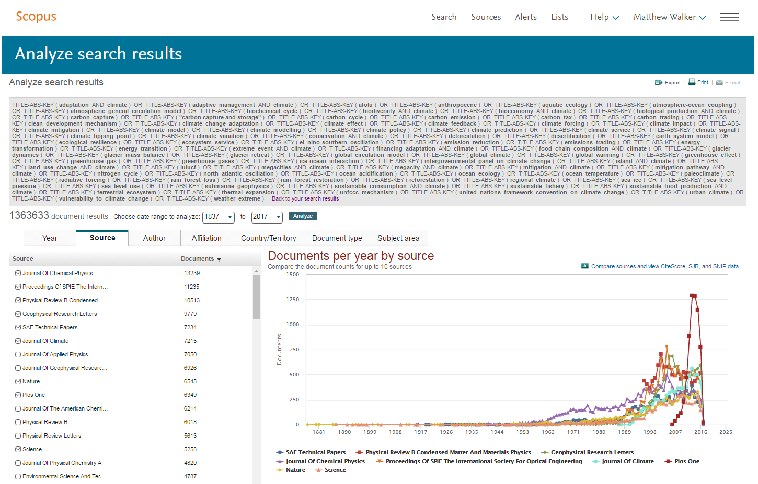
Key sources

Slide 17
4. How to view citation trends for a set of documents, find all publications citing a specific document and discover the overall impact of publications in a research area

Slide 18
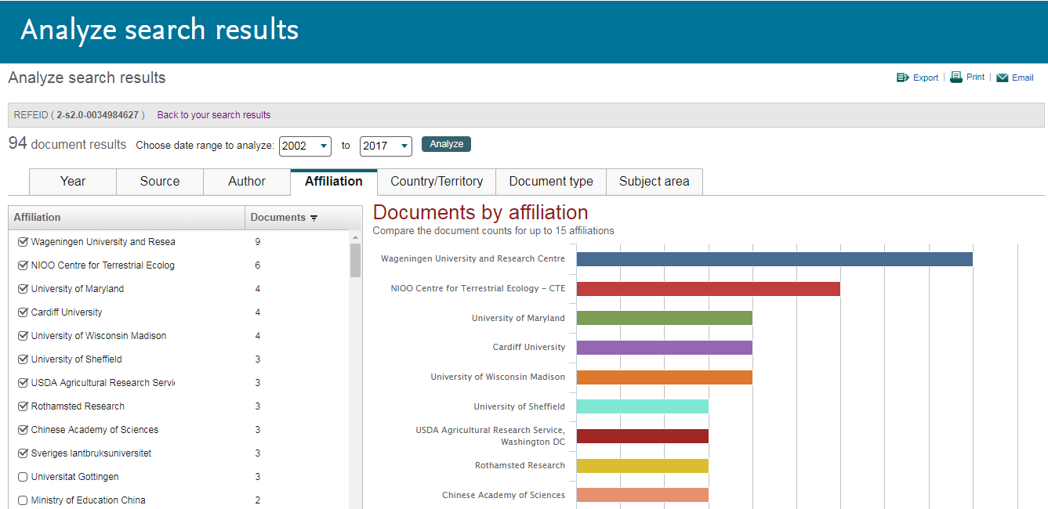
Who is citing my work? Analyze the search results in Scopus

Slide 19
5. Author Profiles and ORCID. Why this is important to check your Author profile and how to use author search find future collaborators / competitors on your topic

Slide 20
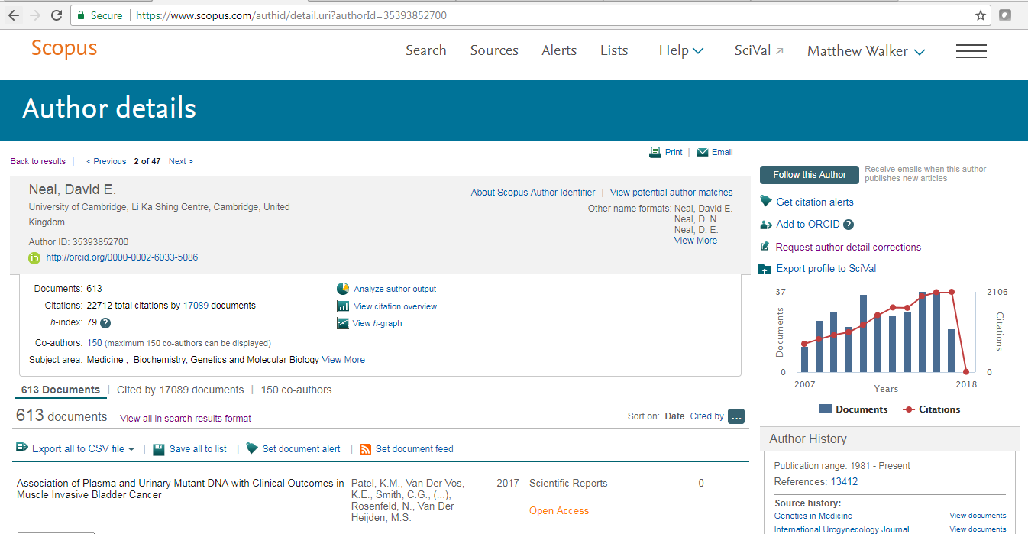
Sample author profile in Scopus: David Neal
Tip: Use Add to ORCID wizard to populate your ORCID & link your Scopus author profile

Slide 21
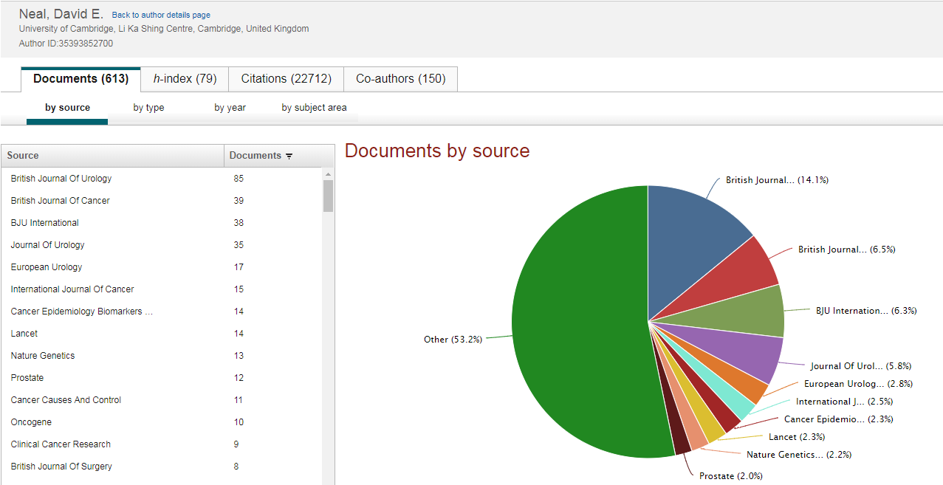
Analysing David’s output in Scopus: where does David publish most of his research?

Slide 22
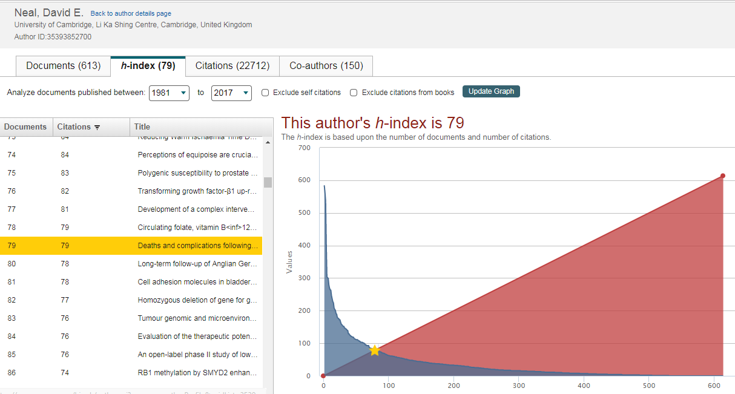
H-index available for period 1970- in Scopus.com

Slide 23
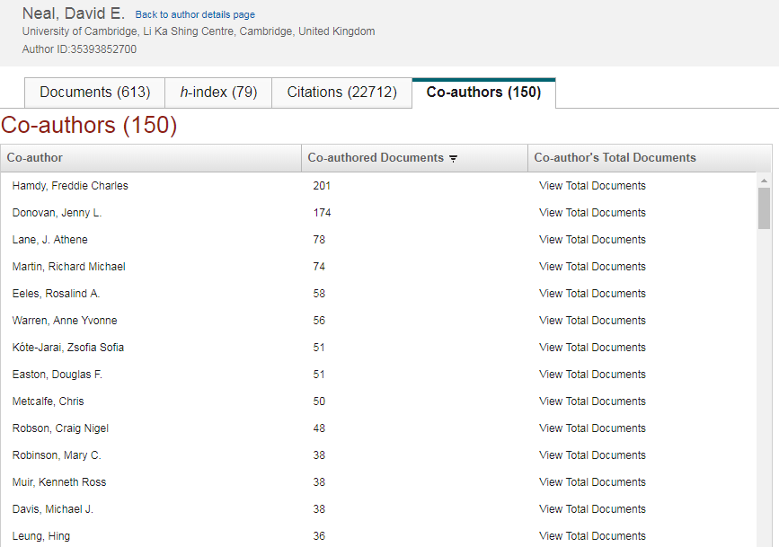
Further information about David’s co-authors

Slide 24
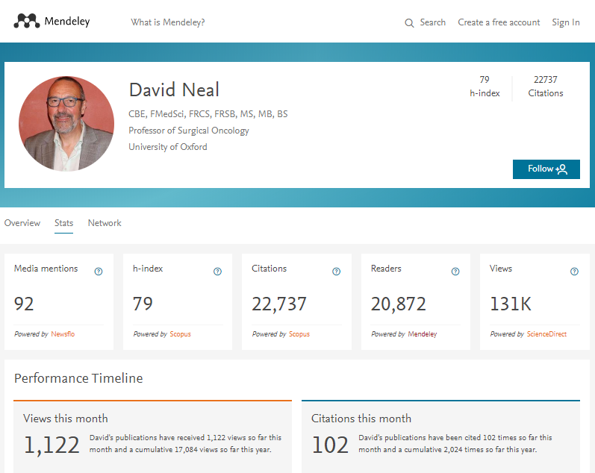
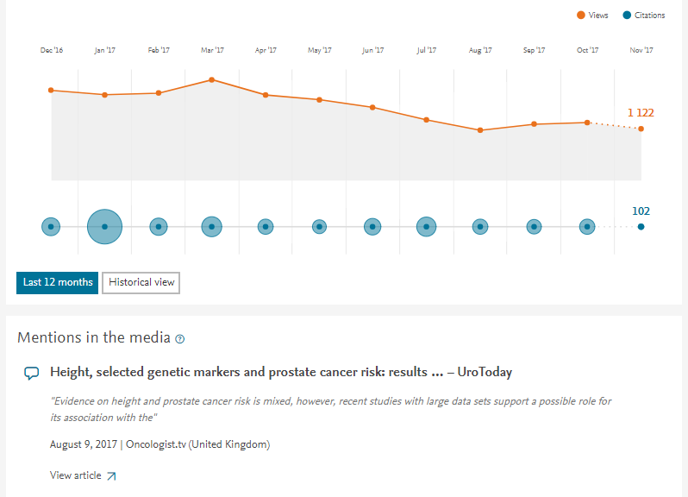
See your Readers & Views* in Mendeley stats too!
https://www.mendeley.com/profiles/david-neal12/stats/
* Views currently only from ScienceDirect

Slide 25
6. Creating Research Areas in SciVal to explore topics and identify key authors and institutions

Slide 26
SciVal modules
SciVal offers quick, easy access to the research performance of 220 nations and >9k research institutions worldwide.
NUI Galway subscribes to all four modules

Slide 27
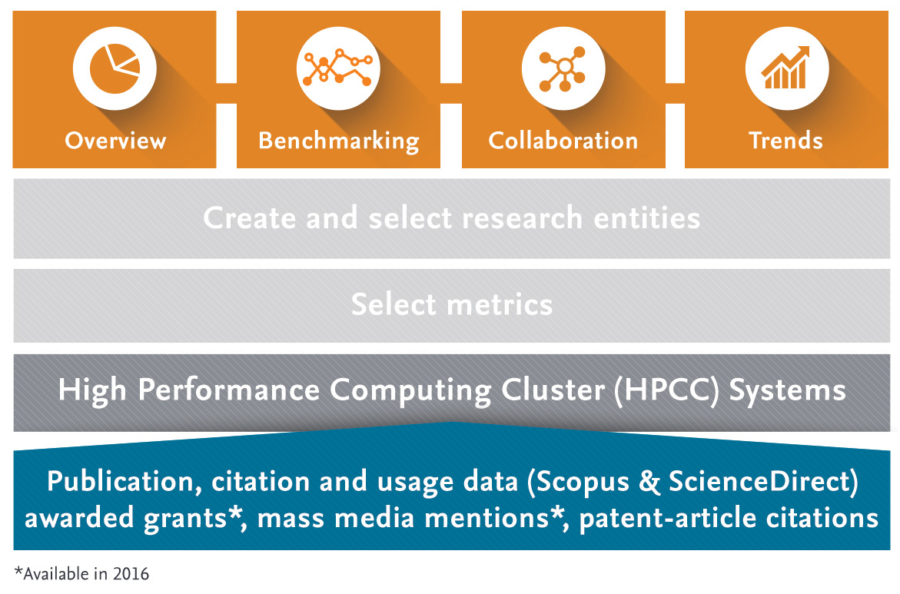
What is SciVal?
Using advanced data analytics super-computer technology, SciVal allows you to instantly process an enormous amount of data to generate powerful data visualizations on-demand, in seconds.
Query over 170 trillion metric values

Slide 28
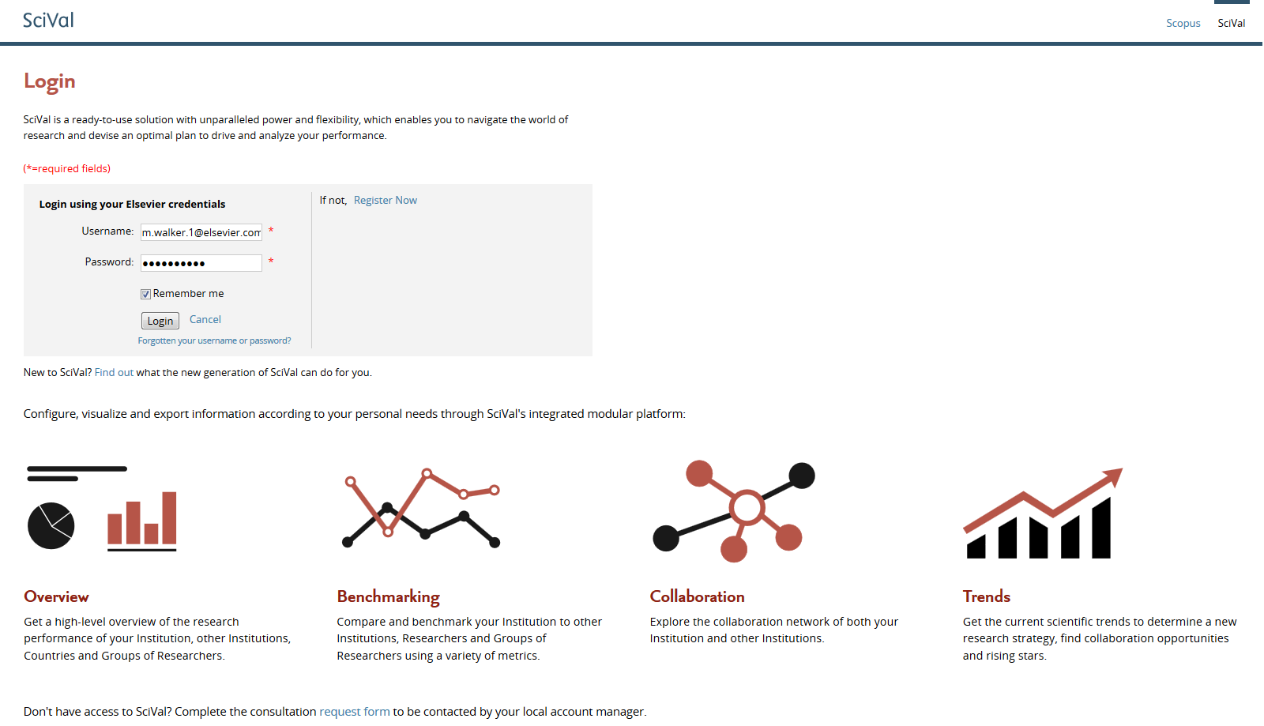
Accessing SciVal at www.scival.com
If you haven’t previously registered for Scopus or ScienceDirect then please go to Register Now

Slide 29
Two Golden Rules of using research metrics
Metrics should be used together with peer review and expert opinion
When metrics and peer review or expert opinion give different answers, probe further
“Metrics” does not only mean bibliometrics
Multiple metrics used together give the richest perspective

Slide 30
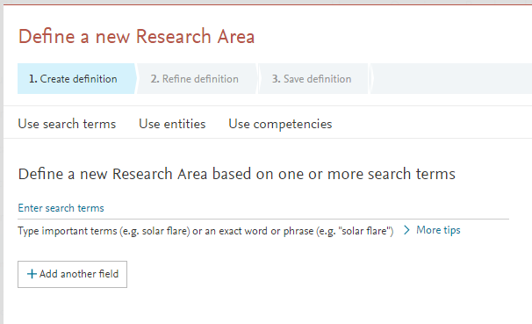
Three options for Research Areas: Keywords, Entities or Competencies

Slide 31
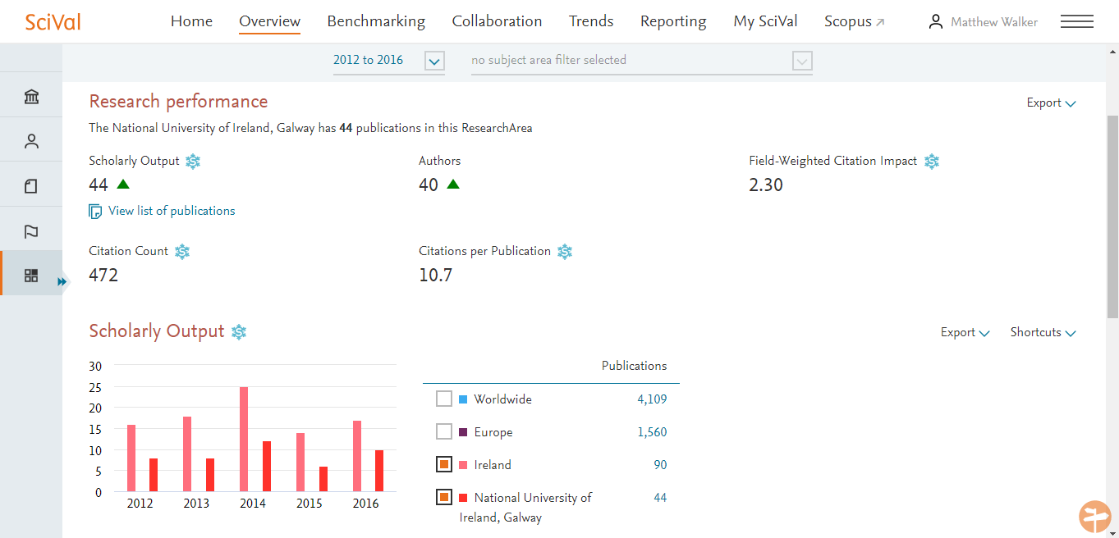
Sample Research Area: macroalgae OR kelp OR "kelp forest"

Slide 32
7. Looking for new collaborators and potential competitors in SciVal Collaboration module

Slide 33
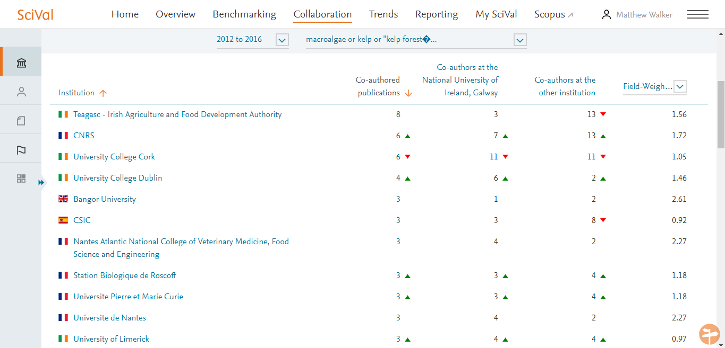
Use your research area as a filter in SciVal Collaboration: collaborators for macroalgae OR kelp OR "kelp forest"

Slide 34
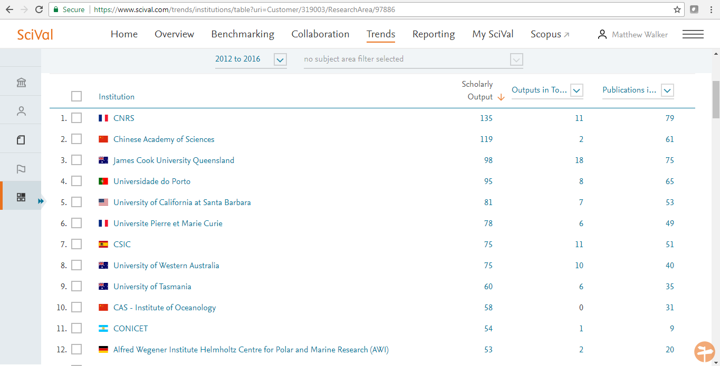
Explore prolific institutions and authors in SciVal Trends: macroalgae OR kelp OR "kelp forest"

Slide 35
8. Benchmarking yourself against others for grant applications and promotion panels

Slide 36
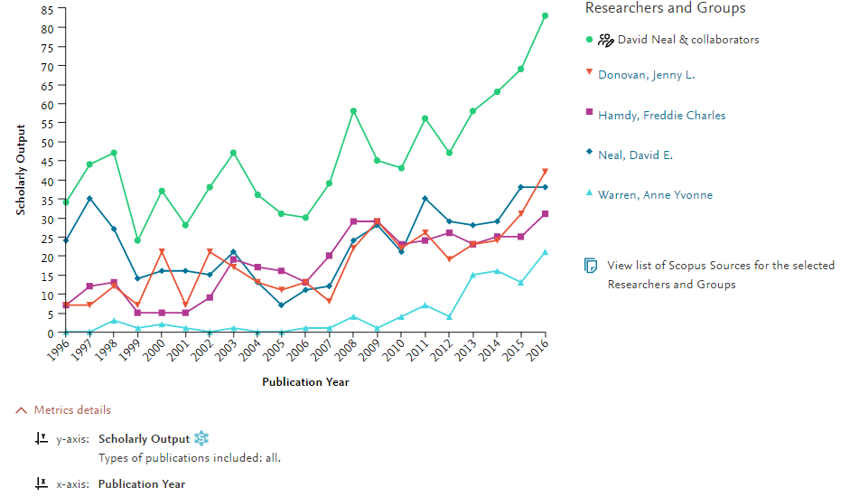
Compare output & other metrics in SciVal Benchmarking

Slide 37
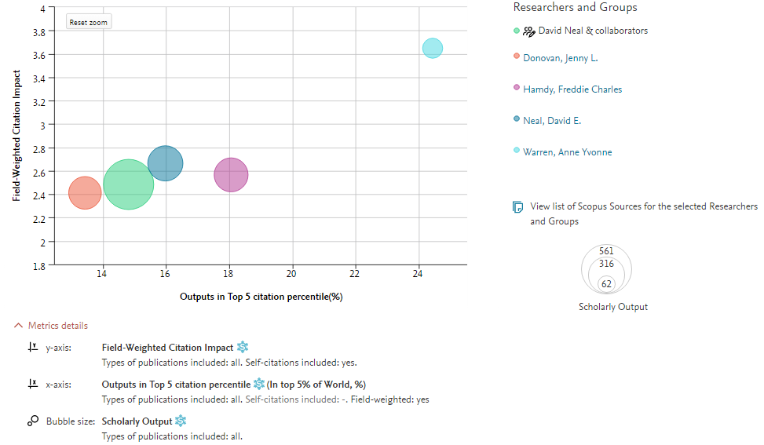
Remember to use multiple metrics!

Slide 38
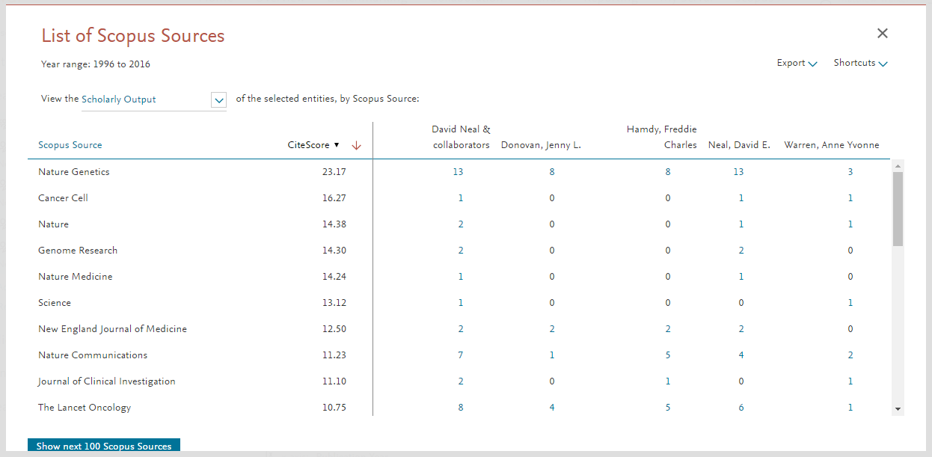
View list of Scopus Sources for complete portfolio
Publishing in prestigious sources may not necessarily result in high citation! Choose the most appropriate source for your work.

Slide 39
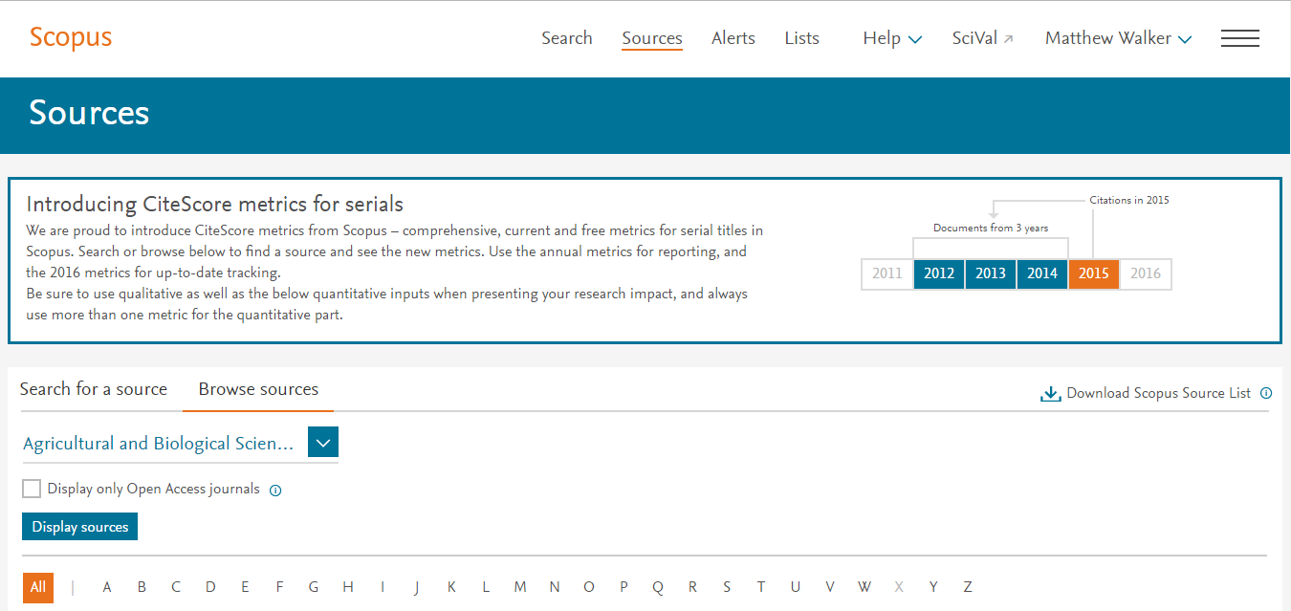
Use Sources in Scopus to see journal metrics for content indexed in Scopus.com

Slide 40
Case Study: Aarhus University
The team faces two main challenges with regards to securing funding:
The first is that the research landscape in Europe has evolved to become more multi-disciplinary, which makes submitting suitable researchers for a funding call more complex.
Secondly the competition for the funding calls has also intensified, so the team needs to ensure that their researchers are supported with evidence to help differentiate them from external candidates.
https://www.elsevier.com/research-intelligence/resource-library/aarhus-university

Slide 41
Recap
A brief introduction to Scopus & its coverage
How to stay up to date in your field, how to personalize Scopus and set alerts to save you time finding relevant information
Advanced search tips for in-depth literature searches, how to analyse and export information, and create lists
How to view citation trends for a set of documents, find all publications citing a specific document (or set of documents) and discover the overall impact of publications in a research area
Author Profiles and ORCID. Why this is important to check your Author profile and how to use author search find future collaborators / competitors on your topic
Creating Research Areas in SciVal to explore topics and identify key authors and institutions
Looking for new collaborators and potential competitors in SciVal Collaboration module
Benchmarking yourself against others for grant applications and promotion panels

Slide 42
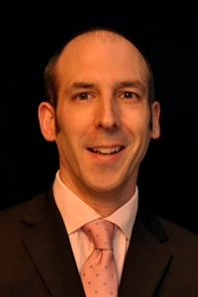
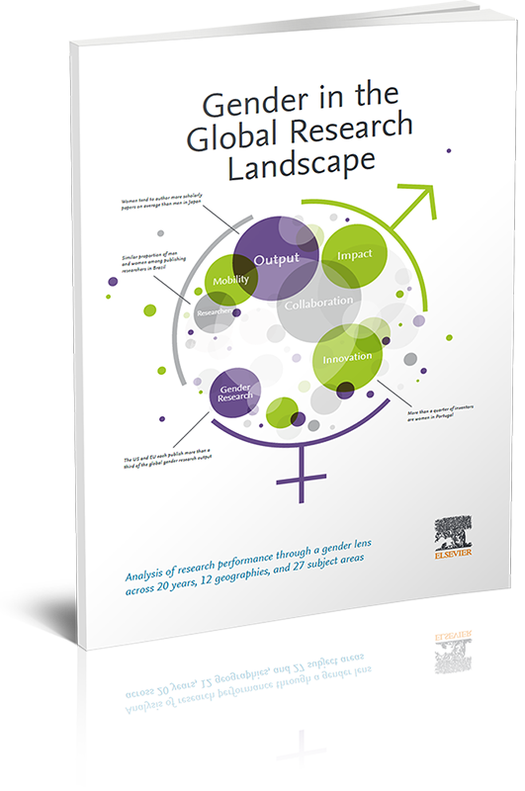
Find out more
Scopus https://www.brighttalk.com/channel/13703/scopus
SciVal https://www.brighttalk.com/channel/13819/elseviers-research-intelligence
NUI Galway SciVal http://www.nuigalway.ie/institutionalresearchoffice/research-metrics/
Contact:
m.walker.1@elsevier.com
See pro bono Elsevier reports in the Research Intelligence Resource Library including Gender in a Global Research Landscape
https://www.elsevier.com/research-intelligence/resource-library/gender-report

