Slide 1




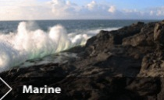

Phosphorus losses following biosolids and meat and bone meal applications to soil
J. Lucid, O. Fenton, J. Grant, M.G. Healy*
ICEPR, Toronto, Ontario, Canada, July 15-17, 2013

Slide 2
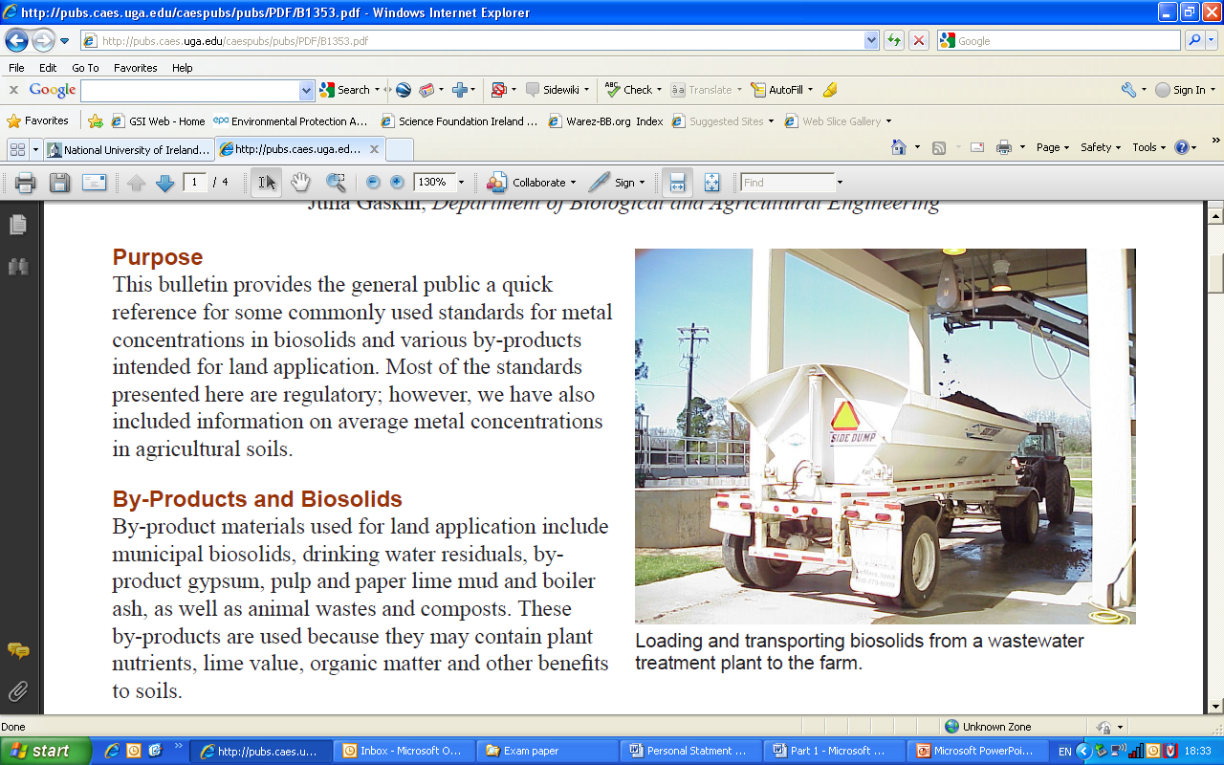

Background
Biosolids are the organic by-product of urban wastewater treatment
Only wastewater which has undergone a recommended treatment process can be classified as biosolids.
These treatment processes may include:
  Anaerobic digestion
  Thermal drying
  Lime stabilisation
  Composting

Slide 3
Background
Council Directive 91/271/EEC
‘Treated waste water shall be reused whenever appropriate’
Council Directive 1999/31/EC (‘The Landfill Directive’)
The disposal of municipal waste is to be ‘reduced to 85% of the total amount produced in 1995’

Slide 4


Background
The application of biosolids to land is governed by various directives and is enacted by federal agencies in each country.
Guidelines do not consider the relationship between
  biosolids application rate
  nutrient availability
and surface runoff of nutrients, solids and metals

Slide 5


Background
Bord Bia, the Irish food board, prohibits raw or treated sludge from being used on Bord Bia certified farms
http://www.bordbia.ie/industryservices/quality/BeefSchemeStandards/Beef%20and%20Lamb%20QAS%20Producer%20Manual.pdf

Slide 6
Background
Meat and Bone Meal (MBM) is the by-product of the rendering industry
Category | Waste includes | Land disposal allowed?
1 | Very high risk material e.g., BSE-infected carcasses
2 | Medium risk material e.g., animals that have died on a farm
3 | Low risk material e.g., catering waste, raw meat and fish
Reg no 1774/2002 http://eur-lex.europa.eu/LexUriServ/site/en/consleg/2002/R/02002R1774-20070101-en.pdf

Slide 7
Background
Meat and Bone Meal (MBM) is the by-product of the rendering industry
Category | Waste includes | Land disposal allowed?
1 | Very high risk material e.g., BSE-infected carcasses | No
2 | Medium risk material e.g., animals that have died on a farm | Yes.. but only after examination
3 | Low risk material e.g., catering waste, raw meat and fish | Yes
Reg no 1774/2002 http://eur-lex.europa.eu/LexUriServ/site/en/consleg/2002/R/02002R1774-20070101-en.pdf

Slide 8

Background
P
Phosphorus (and other nutrients and metals) in biosolids
P
P
P
P
P
P
P
P
P
P
P
P
P
P

Slide 9
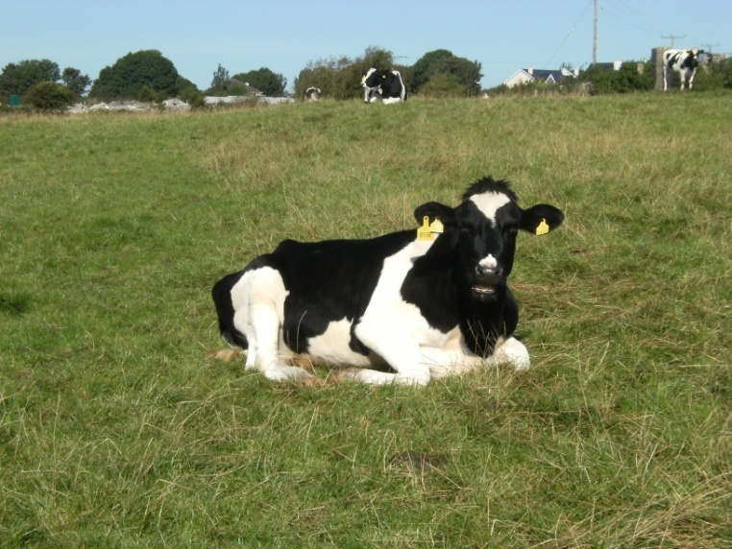
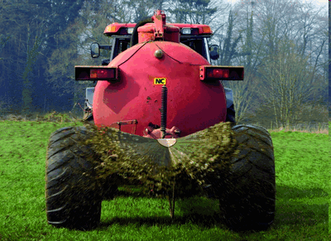

Project Aims
To determine runoff of phosphorus from a grassland soil following application of
lime-stabilised (LS),
thermally dried (TD) and
anaerobically digested (AD) biosolids
and two types of MBM
low ash and high ash content
applied at the maximum legal application rate currently permitted in Ireland over two successive rainfall events (72 h and 240 h after application).

Slide 10
Methodology
Characterisation of biosolids and MBM
 | Nutrients |  | Metals
 | Total P mg kg⁻¹ | Total N mg kg⁻¹ | Cd mg kg⁻¹ | Cr mg kg⁻¹ | Cu mg kg⁻¹ | Hg mg kg⁻¹ | Ni mg kg⁻¹ | Pb mg kg⁻¹ | Zn mg kg⁻¹
AD | 6916 | 6.8 | 0.7 | 30.0 | 169.4 | <0.5 | 30.0 | 27.3 | 576.1
TD | 7600 | 30.8 | 0.7 | 25.2 | 356.7 | 1.3 | 22.2 | 66.2 | 640.3
LS | 6332 | 3.1 | 0.8 | 25.4 | 361.8 | 0.5 | 20.6 | 23.0 | 428.2
MBM (HA) | 27.9 | 39.7 | <0.3 | 1.1 | 6.4 | <0.3 | 0.5 | 1.9 | 67.9
MBM (LA) | 31.1 | 59.1 | <0.3 | 3.1 | 10.6 | <0.3 | 1.5 | 1.9 | 86.2
Characterisation of soil
Determination of application rate
Measurement of surface runoff at laboratory-scale

Slide 11

Methodology
Characterisation of biosolids and MBM
Characterisation of soil
Determination of application rate
 | Nutrients |  | Metals
 | Total P mg kg⁻¹ | Total N mg kg⁻¹ | Cd mg kg⁻¹ | Cr mg kg⁻¹ | Cu mg kg⁻¹ | Hg mg kg⁻¹ | Ni mg kg⁻¹ | Pb mg kg⁻¹ | Zn mg kg⁻¹
AD | 6916 | 6.8 | 0.7 | 30.0 | 169.4 | <0.5 | 30.0 | 27.3 | 576.1
TD | 7600 | 30.8 | 0.7 | 25.2 | 356.7 | 1.3 | 22.2 | 66.2 | 640.3
LS | 6332 | 3.1 | 0.8 | 25.4 | 361.8 | 0.5 | 20.6 | 23.0 | 428.2
MBM (HA) | 27.9 | 39.7 | <0.3 | 1.1 | 6.4 | <0.3 | 0.5 | 1.9 | 67.9
MBM (LA) | 31.1 | 59.1 | <0.3 | 3.1 | 10.6 | <0.3 | 1.5 | 1.9 | 86.2
Characterisation of soil
Determination of application rate
Measurement of surface runoff at laboratory-scale

Slide 12
Methodology
Characterisation of biosolids and MBM
Characterisation of soil
Determination of application rate
 | Nutrients |  | Metals
 | Total P mg kg⁻¹ | Total N mg kg⁻¹ | Cd | Cr | Cu | Hg | Ni | Pb | Zn
AD | 6916 | 6.8 | 0.002 | 0.0261 | 0.2816 | 0.0009 | 0.0181 | 0.0614 | 0.0376
TD | 7600 | 30.8
LS | 6332 | 3.1
MBM (HA) | 27.9 | 39.7
MBM (LA) | 31.1 | 59.1
Characterisation of soil
Metal conc in biosolids | Kg/tonne DS
Determination of application rate
Measurement of surface runoff at laboratory-scale

Slide 13
Methodology
Characterisation of biosolids and MBM
Characterisation of soil
Determination of application rate
 | Nutrients |  | Metals
 | Total P mg kg⁻¹ | Total N mg kg⁻¹ | Cd | Cr | Cu | Hg | Ni | Pb | Zn
AD | 6916 | 6.8 | 0.002 | 0.0261 | 0.2816 | 0.0009 | 0.0181 | 0.0614 | 0.0376
TD | 7600 | 30.8 | 0.05 | 3.5 | 7.5 | 0.1 | 3 | 4 | 7.5
LS | 6332 | 3.1
MBM (HA) | 27.9 | 39.7
MBM (LA) | 31.1 | 59.1
Characterisation of soil
Metal conc in biosolids | Kg/tonne DS
Max rate of metal addit’n | Kg/ha/yr
Determination of application rate
Measurement of surface runoff at laboratory-scale

Slide 14
Methodology
Characterisation of biosolids and MBM
Characterisation of soil
Determination of application rate
 | Nutrients |  | Metals
 | Total P mg kg⁻¹ | Total N mg kg⁻¹ | Cd | Cr | Cu | Hg | Ni | Pb | Zn
AD | 6916 | 6.8 | 0.002 | 0.0261 | 0.2816 | 0.0009 | 0.0181 | 0.0614 | 0.0376
TD | 7600 | 30.8 | 0.05 | 3.5 | 7.5 | 0.1 | 3 | 4 | 7.5
LS | 6332 | 3.1 | 25 | 134 | 27 | 111 | 166 | 65 | 20
MBM (HA) | 27.9 | 39.7
MBM (LA) | 31.1 | 59.1
Characterisation of soil
Metal conc in biosolids | Kg/tonne DS
Max rate of metal addit’n | Kg/ha/yr
Max spreading rate | Tonne/ha/yr
Determination of application rate
Measurement of surface runoff at laboratory-scale

Slide 15
Methodology
Characterisation of biosolids and MBM
Characterisation of soil
Determination of application rate
 | Nutrients |  | Metals
 | Total P mg kg⁻¹ | Total N mg kg⁻¹ | Cd mg kg⁻¹ | Cr mg kg⁻¹ | Cu mg kg⁻¹ | Hg mg kg⁻¹ | Ni mg kg⁻¹ | Pb mg kg⁻¹ | Zn mg kg⁻¹
AD | 6916 | 6.8 | 0.7 | 30.0 | 169.4 | <0.5 | 30.0 | 27.3 | 576.1
TD | 7600 | 30.8 | 0.7 | 25.2 | 356.7 | 1.3 | 22.2 | 66.2 | 640.3
LS | 6332 | 3.1 | 0.8 | 25.4 | 361.8 | 0.5 | 20.6 | 23.0 | 428.2
MBM (HA) | 27.9 | 39.7 | <0.3 | 1.1 | 6.4 | <0.3 | 0.5 | 1.9 | 67.9
MBM (LA) | 31.1 | 59.1 | <0.3 | 3.1 | 10.6 | <0.3 | 1.5 | 1.9 | 86.2
Characterisation of soil
Soil nutrient content is also taken into account when deciding the maximum amount of biosolids to spread
Determination of application rate
Measurement of surface runoff at laboratory-scale
The spreading rate is based on the minimum of the calculated metal and nutrient spreading rate

Slide 16
Methodology
Characterisation of biosolids and MBM
Characterisation of soil
Determination of application rate
Measurement of surface runoff at laboratory-scale

Slide 17
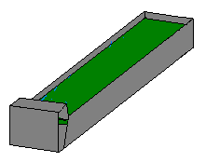
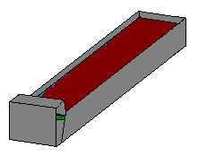
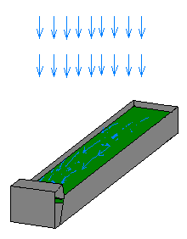
Laboratory-scale study
t= -24 hr Pack runoff boxes, then saturate and allow to drain and reach approx. field capacity
t=0 hr Apply biosolids/MBM
Rainfall simulation:
Intensity 11.5 ± 1mm hr⁻¹
Two 30-min rainfall simulations conducted on each runoff box
t=72 hr RE 1
t=240 hr RE 2
168-hr interval

Slide 18
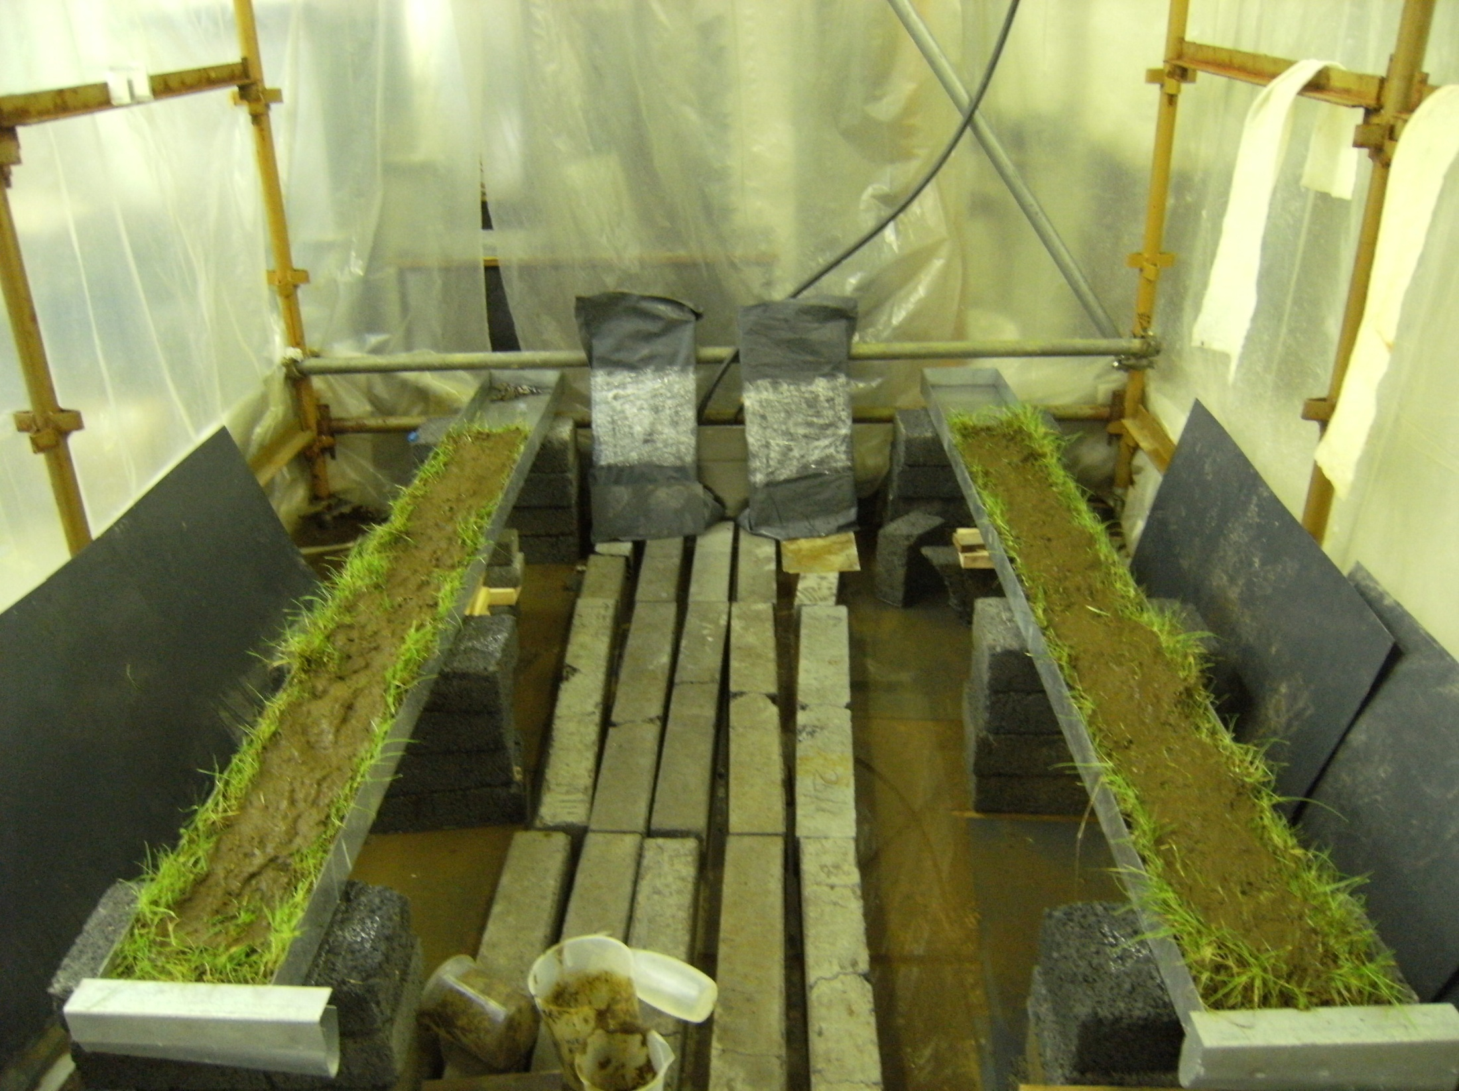
SLOPED RUNOFF BOXES
GRASS SOD
Biosolids or MBM
2 m
0.225 m
Notes:
18
SOIL FLUME SLURRY AMENDMENT RAINFALL SLOPE RUNOFF

Slide 19
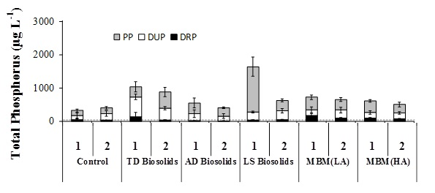
Results
Phosphorus concentrations in runoff

Slide 20

Results
% of dissolved reactive P, particulate P, and dissolved unreactive P in runoff
% of P in runoff

Slide 21
Results
Runoff Ratio (%) – the ratio of surface runoff to volume applied
Runoff ratio (%)
LS Biosolids increased the volume of surface runoff

Slide 22
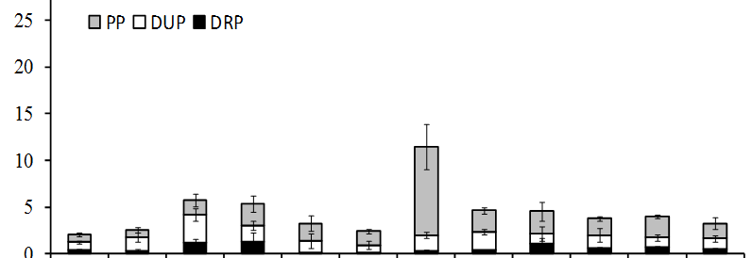
Results
Mass of P released per unit surface area of runoff box
Mass of P released (µg m⁻²)

Slide 23
Conclusions
All biosolids and MBM released DRP concentrations in excess of 30 µg L⁻¹, the concentration over which significant deterioration of surface water bodies may occur.
Of the treatments examined, AD biosolids produced the lowest concentrations of P in surface runoff.
LS biosolids had the highest concentration and mass release in runoff.

Slide 24
Conclusions
Work is currently been undertaken to examine:
  The release of emerging contaminants (EC) (including pharmaceuticals, metals and microbial matter) into the environment
  The link between human health and EC in biosolids
  The impact of biosolids on soil fertility

Slide 25



Acknowledgements

