Slide 1
Comparison of intermittently loaded laboratory filter systems to treat dairy soiled water
Environ 2016
John Murnane, Mark Healy, Owen Fenton

Slide 2
Contaminated washwater from farmyards, milking parlours, silage effluent etc.
BOD₅ < 2,500 mg L⁻¹;
DM content < 1%
Dairy Soiled Water (DSW)
(as defined in SI 31 of 2014)
Issues associated with dairy soiled water
Agronomic issues:-
Increased cost of on farm storage;
Large volumes can be generated from open yard areas during periods of prolonged or high intensity rainfall.
Environmental issues:-
Historically spread to agricultural lands - previously no closed season;
Can result in runoff to surface waters, particularly high when land is saturated, leading to:-
incidental (event specific) P, N and organic carbon in runoff;
can contribute to eutrophication of surface waters – ecology;
can contribute to carbon load in surface waters – may have health implications for downstream water abstraction (trihalomethane formation in presence of high TOC levels)

Slide 3
Study Aim
Generally:-
to compare passive filtration methods to treat DSW;
Specifically:-
to examine the impact of media depth, media type and organic loading rates (OLR’s) on the treatment of DSW by filtration.
Laboratory based study using on-farm DSW which will inform operation of field based unit.

Slide 4
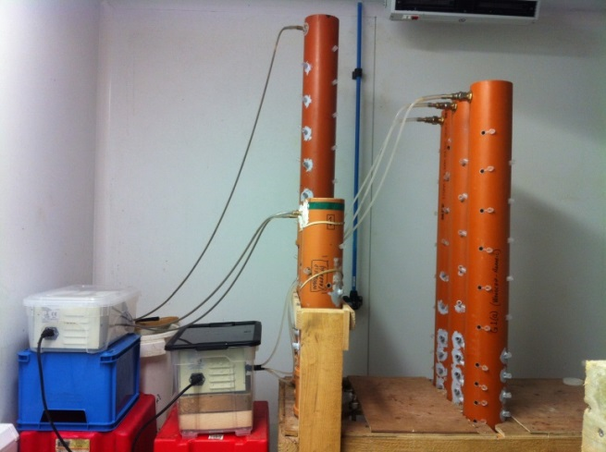
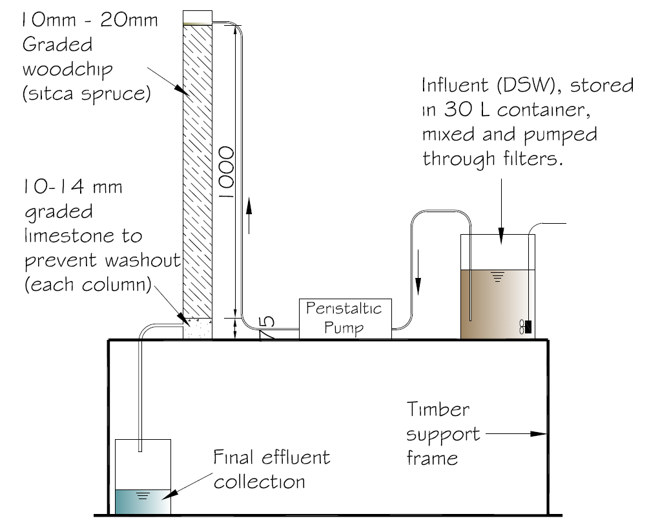
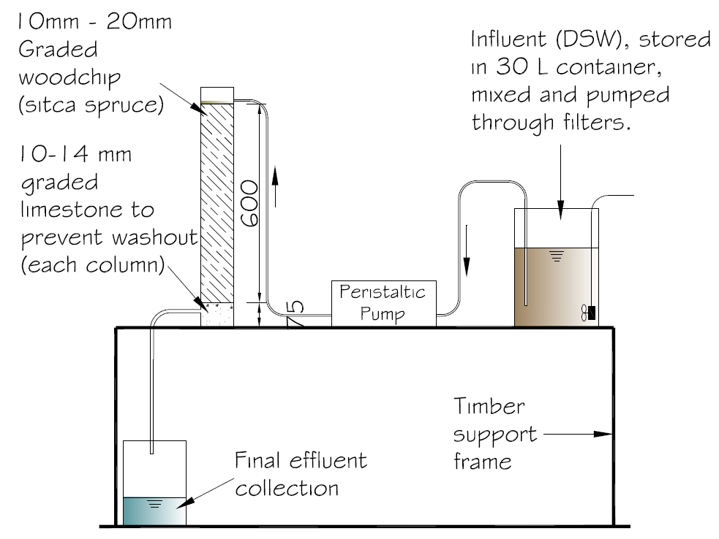
Materials and Methods
Farm generated DSW intermittently loaded onto columns in temperature controlled room
Comparisons:-
Media depth (woodchip 600 mm v 1000 mm) – 100 days, avg. OLR = 120 g COD/m²/d.
Intermittently loaded aerobic columns
600 mm deep woodchip v 1000 mm deep woodchip

Slide 5
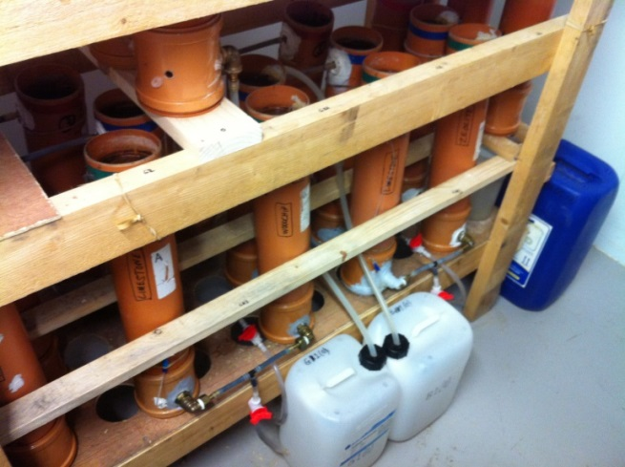
Materials and Methods
Farm generated DSW intermittently loaded onto columns in temperature controlled room
Comparisons:-
OLR (1000 mm woodchip media) – 100 days; 52 v 127 g COD/m²/d.
Treated effluent collection
52 g COD/m²/d v 127 g COD/m²/d

Slide 6
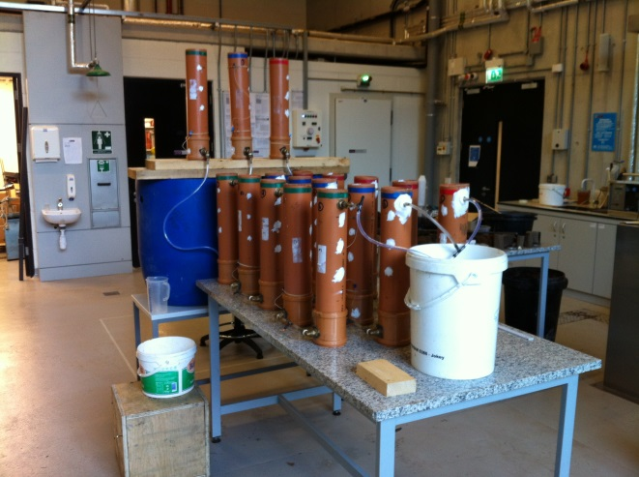
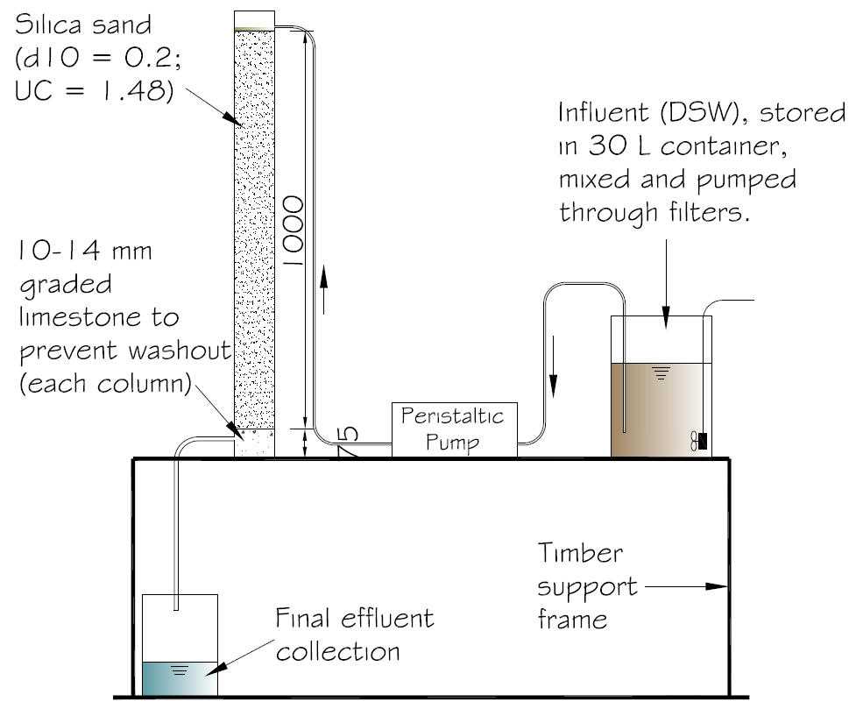
Materials and Methods
Farm generated DSW intermittently loaded onto columns in temperature controlled room
Comparisons:-
Media type (woodchip v sand) – 212 days, avg. OLR = 35 g COD/m²/d
Hydraulic tests being carried out on columns
1000 mm woodchip v 1000 mm sand

Slide 7
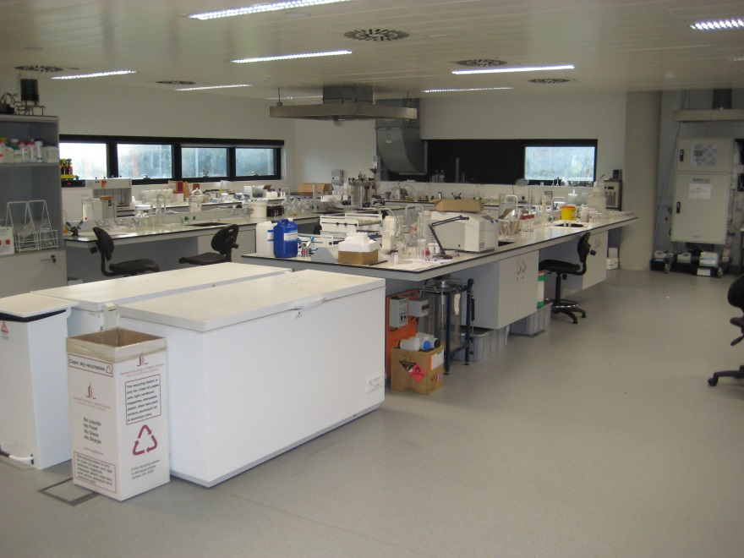
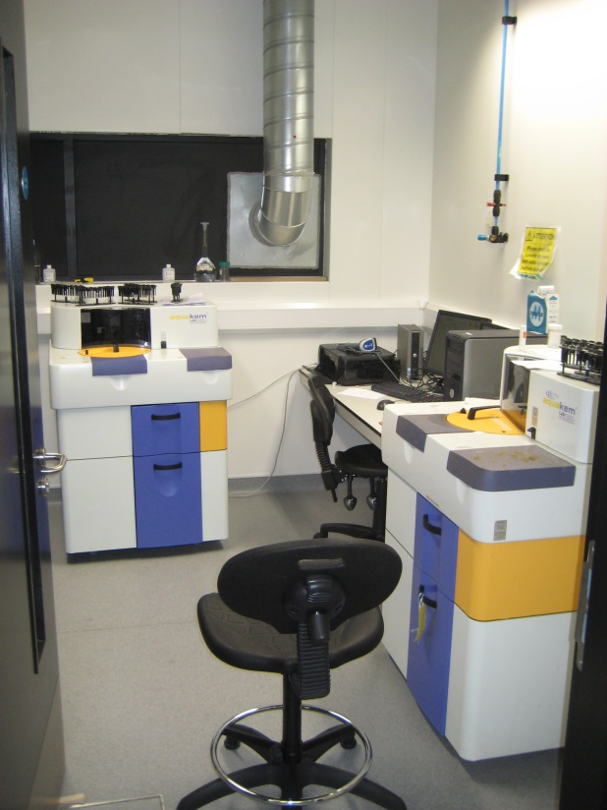
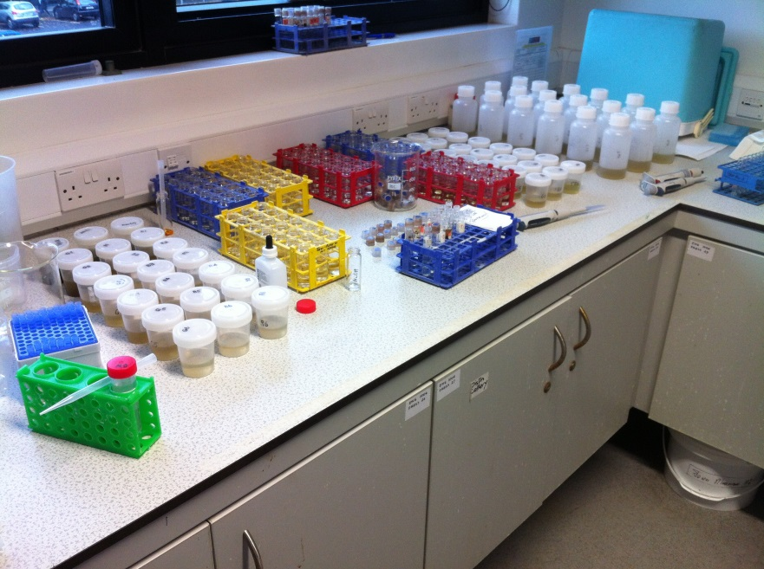
Materials and Methods
Laboratory analyses
Influent & effluent samples tested for:-
COD_{t}, COD_{f}, TOC, TIC;
SS, pH, DM;
TN_{t}, TN_{f}, NH₄-N, NO₂-N, NO₃-N;
TP, TDP, PO₄-P, DUP

Slide 8
Key Results Impact of media depth (woodchip 600 mm v 1000 mm; average OLR = 120 g COD/m²/d)
Suspended solids
SS↓54%
SS↓94%
Higher average SS removals for deeper (1000 mm) woodchip media

Slide 9
Key Results Impact of media depth (woodchip 600 mm v 1000 mm; average OLR = 120 g COD/m²/d)
Ammonium
No reduction
NH₄-N↓82%
Higher average NH₄-N removals for deeper (1000 mm) woodchip media;
No nitrification - both depths

Slide 10
Key Results Impact of media depth (woodchip 600 mm v 1000 mm; average OLR = 120 g COD/m²/d)
Orthophosphate
No PO₄-P reduction
PO₄-P↓51%
Higher average PO₄-P removals for deeper (1000 mm) woodchip media

Slide 11
Key Results Impact of OLR (1000 mm woodchip media; average OLR’s = 52 v 127 g COD/m²/d)
Key contaminants
Parameter | OLR | Average influent | Average effluent | % reduction
 | g COC/m²/d | mg L⁻¹ | mg L⁻¹
COD | 52 | 3,347 | 766 | 77
 | 127 | 3,458 | 606 | 82
TOC | 52 | 377 | 205 | 46
 | 127 | 364 | 199 | 45
NH₄-N | 52 | 47 | 3 | 94
 | 127 | 64 | 5 | 93
PO₄-P | 52 | 15 | 7 | 54
 | 127 | 21 | 10 | 51
SS | 52 | 1,348 | 23 | 98
 | 127 | 632 | 37 | 94
No significant difference between removal rates for the two different OLR’s

Slide 12
Key Results Impact of media type (woodchip v sand; depth 1000 mm; average OLR = 35 g COD/m²/d)
COD
COD↓66%
COD↓94%
Sand has higher COD removal (avg. 146 mg L⁻¹)but woodchip also produces consistent effluent COD (avg. 887 mg L⁻¹)

Slide 13
Key Results Impact of media type (woodchip v sand; depth = 1000 mm; average OLR = 35 g COD/m²/d)
Ammonium
NO₃-N
No difference in NH₄-N removal between sand (97% removal) and woodchip (99% removal);
Nitrified effluent produced by sand filters – initially reasonably high (≈ 50 mg L⁻¹) but then at suppressed levels (≈ 10 mg L⁻¹).

Slide 14
Key Results Impact of media type (woodchip v sand; 1000 mm; average OLR = 35 g COD/m²/d)
Orthophosphate
DRP↓59%
(<150d)
DRP↓100%
(<150d)
Sand has better (complete) DRP removal compared to woodchip up to 150 days, thereafter no significant difference between the two (DRP leaching from both > 150 days).

Slide 15
Summary of key findings
Depth ≥ 1000 mm required for woodchip media to ensure enhanced N, P and SS removals;
Woodchip media depths investigated did not differ significantly for COD/TOC removal;
Woodchip media did not nitrify the effluent at both depths (600 and 1000 mm);
OLR did not significantly impact contaminant removal efficiencies of woodchip filters – robust removals at avg. 52 and 127 g COD/m²/d;
Sand enhances removals of COD, NH₄-N and PO₄-P compared to woodchip at avg. OLR’s of 35 g COD/m²/d and media depths of 1000 mm;
P leaching from sand and woodchip at ≈ 150 days for avg. OLR of 35 g COD/m²/d and media depth of 1000 mm;
Sand media produces consistent but low nitrification levels (≈ 10 mg NO₃-N L⁻¹) at avg. OLR of 35 g COD/m²/d and media depth of 1000 mm.

Slide 16
Implications for on-farm treatment
Taking woodchip as the more robust media:-
Avg. DSW produced per cow = 9,784 L yr⁻¹
Assume treatment at avg. OLR ≈ 90 g COD/m²/d (avg. of 52/127)
Take avg. COD of DSW = 2,750 mg L⁻¹
Filter area required for 100 cow unit = $\frac{9784 x 100 x 2,750 g COD d^{−1}}{365 x 1000 x 90 g COD m^{2} d^{−1}}$ = 82 ${say 85 m}^{2}$
BUT
media needs to be replaced every 80 – 100 days to prevent P breakthrough (i.e. 3 – 4 times per year).
Observations:-
Removal of SS to prevent clogging of filter media is a very important consideration for operation of filters (need settlement tank prior to loading onto filter);
Filters will only work with good on-farm management – important not to let the solids build up and regular media replacement;
DSW strength varies significantly and seasonally – particularly strong in Spring when cows on grass for first time after being housed for the winter.

