Slide 1
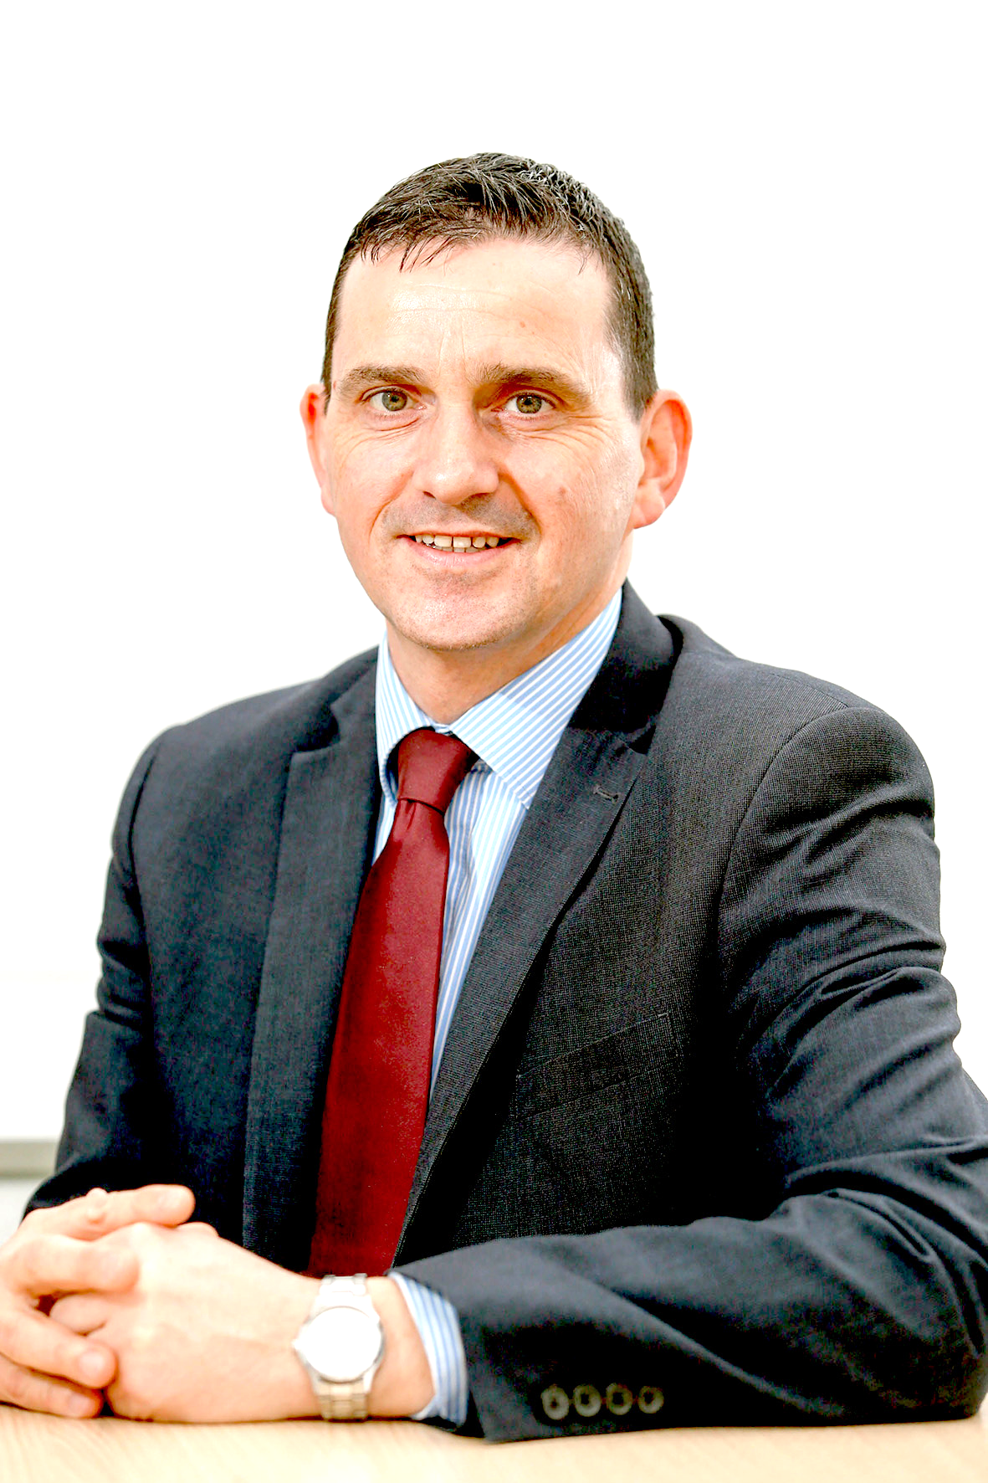
NUI GALWAY PENSION & RETIREMENT PLANNING PRESENTATION - AVCs
Presenter: Noel Hackett – QFA, RPA, PTP, Senior Pension Consultant

Slide 2
Individual ZOOM Consultations Available
Noel Hackett will be available (08:30-17:00) on selected dates for
for Confidential Individual Consultations- contact Pensions office.
Email: Pensions@nuigalway.ie To organise a TEAMS meeting.
In light of Covid 19 Working restrictions- limited resources as all people working from home, please have a Payslip, and a recent Pension Benefit Statement ( access either through your Core HR online facility, or use previous one issued by the Pension Office) and email to Noel.hackett@newireland.ie in advance of a confirmed meeting.
Please note the Pensions Office will not be able to provide these to you during these times.

Slide 3
Agenda – Duration 30 mins
What is Financial Planning.
Your Main NUI Galway Pension Schemes
Sample Pension Benefit Statement- Scope for Notional Years and AVCs ESMA Risk Rating Scale 1-7
Don’t Try this at home!! Investing Explained- threats/opportunities
Fund Choice, Fund Manager, Fund Performance and Fund availability under your AVC Scheme
THIS SHOULD BE PART OF YOUR OVERALL FINANCIAL PLAN.
“most people don’t plan to fail, they fail to Plan”-J Beckley

Slide 4
About New Ireland
Presence in Galway since 1960s. Current office Atlanta House Dominick Street

Slide 5
My View on What Financial Planning Is About!
Planning is bringing the FUTURE into the PRESENT so that YOU can do SOMETHING about it NOW
Financial Planning is TELLING your money where to go; rather than WONDERING where it went!
A good sound Financial Plan executed NOW is better than a PERFECT PLAN executed next month/Year or in many cases never gets put into place.
Most people don’t PLAN to FAIL-they simply FAIL to PLAN
Benjamin Franklin “An Investment in Knowledge pays the best Interest”
Albert Einstein ( Investing/Saving) “Compound Interest is the 8th Wonder of the World; He who understands it, earns it; he who doesn't, pays it.”

Slide 6
YOUR INCOME-Benefits at Retirement
At retirement your benefits will come from:-
State Pension ( PRSI Contributions)
NUIG Scheme (s)
Purchase of Notional Years
Additional Voluntary Contributions ( AVCs )
Personal Accumulated wealth/savings inheritances
Retained Benefits from Previous Employments

Slide 7
NUIG Pension Scheme
Defined Benefit Scheme
Scheme provides
Pension
Lump Sum ( Gratuity )
Spouses Pension
Increases during course of payment ( SPS by CPI factor)
Other scheme by Ministerial Order based on pay in job)
Death in Service Benefit
Actual benefits depend on when you joined
Please refer to your NUIG Annual Benefit Statement.
( Individual Consultations with Noel Hackett)

Slide 8
Key Dates
Pre 95 – no state pension, higher pension through NUIG
Post 95 - employees pay PRSI and receive:
State Pension
Lower pension from NUIG
2004
Future employees have minimum RA of 65
Immediate early retirement pension available to:
Existing employees from 50
New employees from 55
2013- Career Average Earnings SPS Pension Scheme

Slide 9
State Pension
From 2022
Single Person: €253.30 per week
Married Couple: €480.80 per week ( adult dependent)
Applies to all employees who joined since 1995
State Pension 2014 from age 66
2021 from age 67 –Proposed?
2028 from age 68- Proposed?
(Social Welfare will pay Job Assist or other S/W payment- where for whatever reason S/W payment not allowed, a Supplementary Pension maybe paid by NUIG )
2,080 is the new magic number under TCA 2020.
Total Contributions Approach where you need 40 yrs of 52 weekly contributions paid/credited PRSI. If you have only 1,560 contributions (30 yrs) then YOU get 1560/2080 of full rate, or 75% of the full rate –Eg €186.22 per week.
KEY CHANGE NOW for women is you will qualify upto 20 yrs, or 1,040 contributions

Slide 10
Early Retirement
Was always allowed but only as a deferred pension
Changes from 2004
Existing employees from 50
New entrants from 55
Immediate pension payable
Early payment reduction

Slide 11
Bridging the Gap – Making Up the Shortfall Financial Planning
Purchase of Notional Years of Service (Model, JPS Schemes)
Through NUI Galway Pensions Office
2Purchase of Referrable Amounts in SPS Pension Scheme
AVC Scheme
Through New Ireland Assurance
“An Investment in knowledge pays the best interest”-Benjamin Franklin

Slide 12
Notional Years Service
Employee can buy “notional years”
Defined Benefit basis
Must buy year with all the “trimmings”
Pension
Gratuity
Spouses Pension
Pension Increases

Slide 13
AVC Scheme Additional & Voluntary
Tax Relief
Tax free growth
Fund Choice
Flexibility
Options at retirement
Inheritance Tax Planning
Fund for tax free lump sum, taxable lump sum

Slide 14
HOW /Where You CAN YOU “USE” AVCs
If you are short Service ( 40 yrs)- this reduces your pension and Retirement lump sum from NUIG. If you have less than 40- you can use AVC or Purchase notional years to tax efficiently improve your benefits at retirement.
If you have the options of 60ths only Pension from your scheme- you can use an AVC to build up/fund for your TAX FREE LUMP SUM-electing/planning to take Higher Pension Only from NUI Galway Scheme.
Best of both worlds- Higher 60ths Pension, and tax free lump sum from AVC- Within Revenue rules, and depending of level of benefits provided by NUI Galway and other preserved/retained benefits.
SPS pension lump sum is based on yearly accruals- whereas Revenue will permit 1.5 times your final salary as a Tax free lump sum- thus Gap/shortfall/opportunity to boost TAX FREE LUMP SUMS!

Slide 15
Employee Tax Relief Limits (including AVCs)
Age % of Remuneration
Up to 30 15%
30 - 39 20%
40 - 49 25%
50 - 54 30%
55 - 59 35%
60 + 40%
An earnings cap of €115,000 (2022 apply to Employee Pension Contributions for the purpose of tax relief- unchanged for several years) The above limits include contributions to NUIG Pension Scheme

Slide 16
Tax Relief – The Importance!!!
Monthly Contribution €100.00
Standard rate Marginal Rate
Tax Relief €20.00 €40.00
Net Cost €80.00 €60.00
Saving in Bank/Credit Union
Earn gross either €120 or €135.00 before PAYE/PRSI/USC/PRD
€100.00 net invested in Bank/Credit Union
Then its subject to DIRT Tax currently 33% and PRSI 4%
OR
Save €100.00 in Pension ( AVC or Purchase Yrs) that costs you €60.00 or €80.00 or
Save €100.00 that costs you €120.00 or €135.00
Contributions and tax relief operated at source

Slide 17
Commuting Salary for LUMP sum.
Decision to Take Tax free Lump sum or Higher Pension on the 60ths Pension Scheme.
This Case
Pension of €12,772 per annum Or Pension of €8,122 per annum + €42,239 Lump
By taking lump from Pension You are losing/comuting €4,650 per annum Guaranteed for LIFE
Divide Lump sum by €4650 and that equals 9.08 YRS
So if you were to live for at least 9 yrs post retirement or longer then You need to consider the VALUE, the correct choices to be considered.
OR:
Use AVC to fund Tax Free Lump Sum, and elect to take Higher /Pension Only, 60ths Pension from NUI Galway= THE BEST OF BOTH WORLDS!!
PROBABLY????

Slide 18
Back-dating AVC Investment for Tax Year 2021
You can elect to back-date a Lump sum payment into your AVC fund
This must be with New Ireland, and an RAC letter issued by New Ireland delivered/posted to Revenue before 31st October 2022
Don’t leave it too late, act early if this mechanism is appropriate for you. Must be done before Friday, 21st October 2022
Eg: €10,000 Single premium to AVC for 2021 €10,000.00 (invested )
Rebate cheque from Revenue @20%or 40% -€4,000 or -€2000 cheque back to you from Local Inspector of Taxes.
Net Cost to you is either €6,000 or €8,000.00

Slide 19
ESRI Report to Govn- Pension Reform
20% relief on pension contributions would save €1bn in Tax
30% relief on pension contributions would save €420m in Tax
Currently relief is at 20% - Standard or 40%- marginal rate.
Proposed Cap on Earnings for Pension contributions?
Currently €115,000
Possibly €57,500???

Slide 20
ESMA RISK RATING – What is yours?
European Securities Market Authority (ESMA) Jan 2014
Guidelines on all investment funds throughout Europe assessed for risk rating
1-very low 2 -Low risk 3- low to medium 4- medium risk
5- medium to high 6- high risk 7- very high risk
Questionnaire 15 questions using EValue to ascertain your Risk profile
Email Noel.hackett@newireland.ie and ask for Questionnaire, and your free Report.
Risk for both regular investing and lump sum investments.
PRIIPs-Packaged Retail Investment Products Regulation- KID- Key Information Document
Scale like ESMA- but different- based on past 5-7 Years

Slide 21
AVC Account- Pensions on line Facility
www.newireland.ie Pension Schemes On Line (PSOL )
To track your own pension account
Secure access to your account
Values updated daily
NEW enhancements to On Line Facility-Annual Benefit Statements on line shortly PLUS more!!!
New Ireland Investment Centre http://fundcentre.newireland.ie
Up to date price\performance information
Monthly factsheets – include asset split, fund size etc
Graph performance of funds

Slide 22
Volatility in Investment Markets My Definition: Volatility should be viewed as the cost(price) of good long term performance, not a risk to be avoided.
Should I worry?
“good news” can be BAD news for the markets
“bad news” can be GOOD news for the markets
“no news” can equal CALM in the markets
Interventions by Central Banks Globally not always positive/ Or Helpful in the markets.
There has been 26 Bull Market runs and 25 Bear Market runs
Bull- markets advancing/growing/rising. “Bull thrusts his horns up into the air, attacking their opponents” Bear Market- Falls of over 20% in Stock market in 2 months etc
Can last about 18 months.
“ A bear swipes it paws downwards in attacking it opponents”
Old Saying I learnt years ago:
“Bulls make money, Bears make Money- but Pigs get slaughtered, make the bacon”!

Slide 24
In Summary/ REVIEW what we covered today
The Need for Financial Planning- including retirement advice
Understanding the benefits that you are going to receive from NUI Galway ( and other sources) at Retirement date.
How you can enhance your retirement benefits- with knowledge of the tax incentives that are available
Understanding where Additional Voluntary Contributions (AVCs) and Purchase of Notional Years Service can fit in to your financial Planning
Investment Fund suite under the NUI Galway AVC scheme
How the various investment funds work
Details of the various Global Fund Managers available through New Ireland Assurance.
The need for YOU to GET –KNOWLEDGE/INFORMATION and ADVICE specifically for YOU- Tailored Advice from a Qualified Financial Advisor and Retirement Planning Practitioner

Slide 25
Individual TEAMS Consultations Available
Noel Hackett will be available (08:30 – 17:00pm)
for Confidential Individual Consultations on the selected dates
Email / Contact: Pensions@nuigalway.ie
Consultations for 30 minutes duration by appointment. Please have your Payslip current and December 2021 and Annual Benefit Statement emailed to Noel.hackett@newireland.ie in advance of meeting.

Slide 26
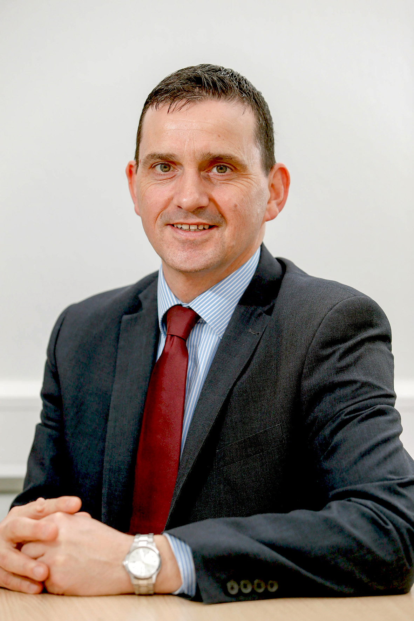
Who Should I Contact:
Pensions Office NUI Galway
Email: pensions@nuigalway.ie
Noel Hackett, QFA,RPA, Pensions Consultant
New Ireland Assurance, Atlanta House,
36 Dominick Street, Galway
Tel: (091) 566225
Mobile: 086- 8186163 Email: Noel.hackett@newireland.ie

Slide 27
Helping you plan your Retirement

