Slide 1
Brain Awareness Week
Quiz
National University of Ireland Galway
February 2018
By Joëlle Bizeau
Marie Skłodowska-Curie Fellow in the BrainMatTrain project

Slide 2
There are strange people in the world who choose to spend their lives doing experiments and searching for answers to questions or solutions to problems

Slide 3
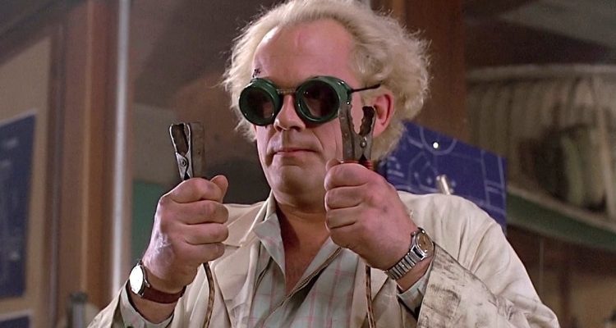
Perhaps you think that they look like this

Slide 4
Or like this

Slide 5
Or even like this

Slide 6
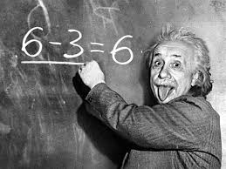
But they are people like you!

Slide 7
There are a lot of laboratories where researchers can perform experiments and focus on many different things!
This quiz will help you discover an area of research!
Select an answer by clicking on the round button and go to next question by clicking on the arrow. You can select only one answer per question.

Slide 8
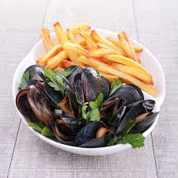
Question 1
How do you think mussels can help scientists?
By eating them with french fries
By using the shells to fabricate new things
By using them as an inspiration to create new things

Slide 9
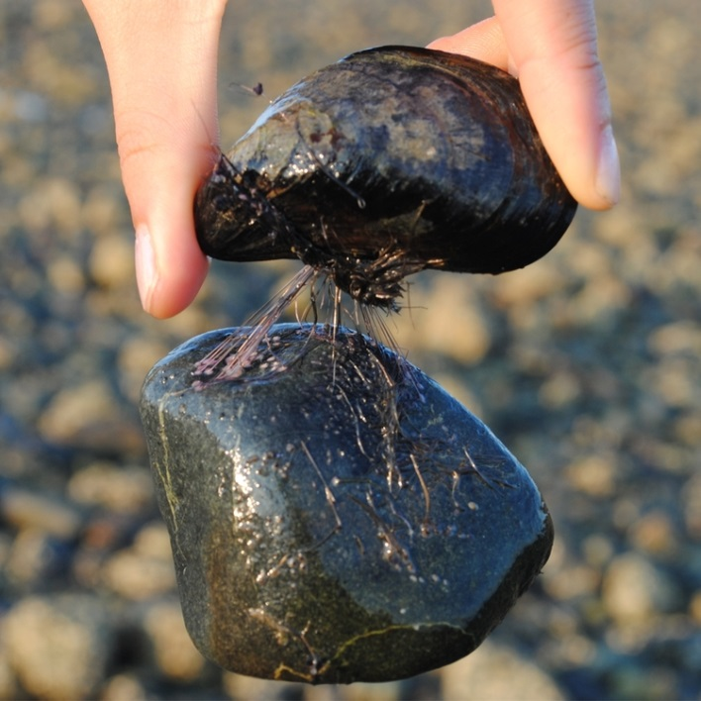
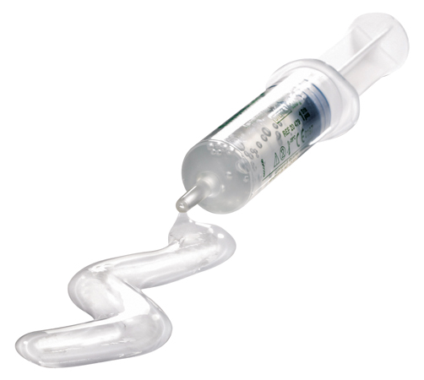
Congratulations !
How do you think mussels can help scientists?
By eating them with french fries
By using the shells to fabricate new things
By using them as an inspiration source to create new things
Mussels can be strongly fixed to very different surfaces. Researchers found the molecules that create this adhesion and use it in many different applications. One of these applications is a bioadhesive gel that can heal a cut in the skin. Thanks to this molecule, the gel stays in the cut and can cure it with greater efficiency!

Slide 10
Ooooh…You will be better next time!
How do you think mussels can help scientists?
By eating them with french fries
By using the shells to fabricate new things
By using them as an inspiration source to create new things
Mussels can be strongly fixed to very different surfaces. Researchers found the molecules that create this adhesion and use it in many different applications. One of these applications is a bioadhesive gel that can heal a cut in the skin. Thanks to this molecule, the gel stays in the cut and can cure it with greater efficiency!

Slide 11
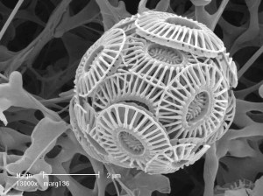
Question 2
What do you think this is?
Bacteria
Aliens hugging
Phytoplankton
A quaffle to play Quidditch
Notes:
http://moocs.southampton.ac.uk/oceans/2015/09/02/kyle-mayers-my-research/

Slide 12
Congratulations!
What do you think this is?
Bacteria
Aliens hugging
Phytoplankton
A quaffle to play Quidditch
This is a phytoplankton, more precisely, a coccolitophore. And even more precisely, a specific coccolitophore called Emiliania huxleyi. It is so small than even with a powerful microscope, you will not be able to see it. We need a different type of device to take a picture like this! But the most amazing thing is that when there are a lot of Emiliania huxleyi in the same place, you can see them from space! Look at this creamy patch on the ocean!
Emiliania Huxleyi bloom, picture took by NASA from space

Slide 13
Ooooh…You will be better next time!
What do you think this is?
Bacteria
Aliens hugging
Phytoplankton
A quaffle to play Quidditch
This is a phytoplankton, more precisely, a coccolitophore. And even more precisely, a specific coccolitophore called Emiliania huxleyi. It is so small than even with a powerful microscope, you will not be able to see it. We need a different type of device to take a picture like this! But the most amazing thing is that when there are a lot of Emiliania huxleyi in the same place, you can see them from space! Look at this creamy patch on the ocean!
Emiliania Huxleyi bloom, picture took by NASA from space

Slide 14
Question 3
What do you think this is for?
Listening to music
Replacing a dysfunctional
bone
Acting as a brake on a bike

Slide 15
Congratulations!
What do you think this is for?
Listening to music Replacing a dysfunctional
bone
Acting as a brake on a bike
This is a hip joint. It’s a prosthesis made with titanium, ceramics or a mix of different materials and it is used when the bone is broken or to replace tendons and ligaments.

Slide 16
Ooooh…You will be better next time!
What do you think this is for?
Listening to music Replacing a dysfunctional
bone
Acting as a brake on a bike
This is a hip joint. It’s a prosthesis made with titanium, ceramics or a mix of different materials and it is used when the bone is broken or to replace tendons and ligaments.

Slide 17
The things that you just saw are biomaterials. Researchers have a definition for them, and a list of properties that these biomaterials need to have to be efficient and validated.
Continue the quiz to discover what these are!

Slide 18
Question 4
A biomaterial is made from…
Natural materials: nature makes them and then humans use them to fabricate a biomaterial
Synthetic materials: these are fabricated completely by humans
Natural or/and synthetic materials

Slide 19
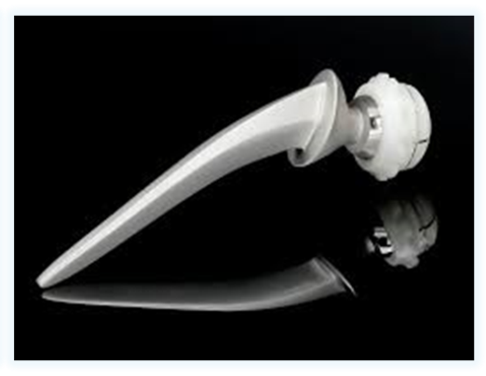
Congratulations!
A biomaterial is made from…
Natural materials: nature makes them and then humans use them to fabricate a biomaterial
Synthetic materials: these are fabricated completely by humans
Natural or/and synthetic materials
A biomaterial can be made from natural materials like plants or from synthetic material like plastic or metal, but it can also be a combination of a natural and a synthetic material.
Natural
(coccolith from coccolithophore)
Synthetic

Slide 20
It’s true, but…
A biomaterial is made from…
Natural materials: nature makes them and then humans use them to fabricate a biomaterial
Synthetic materials: these are fabricated completely by humans
Natural or/and synthetic materials
A biomaterial can be made from natural materials like plants or from synthetic material like plastic or metal, but it can also be a combination of a natural and a synthetic material.
Natural
(coccolith from coccolithophore)
Synthetic

Slide 21
Question 5
A biomaterial…
Has to be temporary, which means that it has to disappear after a period of time
Has to be permanent, which means that it has to stay in the body during a lifetime
Can be either temporary or permanent

Slide 22
Congratulations!
A biomaterial…
Has to be temporary, which means that it has to disappear after a period of time
Has to be permanent, which means that it has to stay in the body during a lifetime
Can be either temporary or permanent
This property of a biomaterial is linked to what we want to do with it. If, for example, you lose a tooth when you are an adult and you want a new one, you want it to be permanent.

Slide 23
Ooooh…You will be better next time!
A biomaterial…
Has to be temporary, which means that it has to disappear after a period of time
Has to be permanent, which means that it has to stay in the body during a lifetime
Can be either temporary or permanent
This property of a biomaterial is linked to what we want to do with it. If, for example, you lose a tooth when you are an adult and you want a new one, you want it to be permanent.

Slide 24
Question 6
A biomaterial has to be biocompatible, which means several things. Which one of these is wrong?
The body must not fight or attack the biomaterial
The biomaterial can cause allergic reactions
The biomaterial cannot be toxic
The biomaterial cannot cause inflammation

Slide 25
Congratulations!
A biomaterial has to be biocompatible, which means several things. Which one of these is wrong?
The body must not fight or attack the biomaterial
The biomaterial can cause allergic reactions
The biomaterial cannot be toxic
The biomaterial cannot cause inflammation
The main purpose of a biomaterial is to help the body. It can fight against a microbe or replace a part of the body that is missing. So it is absolutely necessary that it doesn’t cause any problem. If there is an allergic reaction, for instance, we have to find a new material that does not cause this reaction.

Slide 26
Ooooh…You will be better next time!
A biomaterial has to be biocompatible, which means several things. Which one of these is wrong?
The body must not fight or attack the biomaterial
The biomaterial can cause allergic reactions
The biomaterial cannot be toxic
The biomaterial cannot cause inflammation
The main purpose of a biomaterial is to help the body. It can fight against a microbe or replace a part of the body that is missing. So it is absolutely necessary that it doesn’t cause any problem. If there is an allergic reaction, for instance, we have to find a new material that does not cause this reaction.

Slide 27
Question 7
Which form can have a biomaterial?
Fiber
Sphere
Sponge
Mesh
A lot!

Slide 28
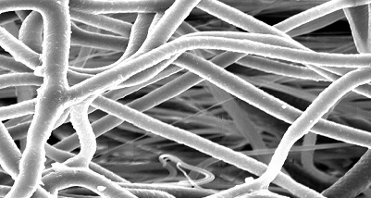
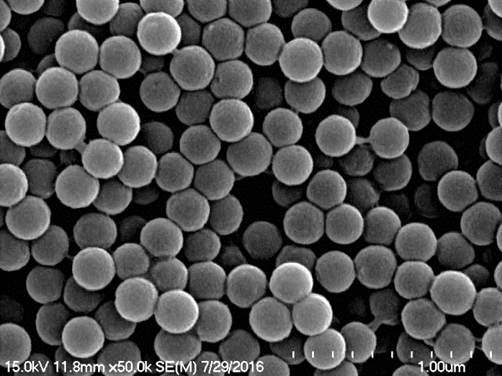
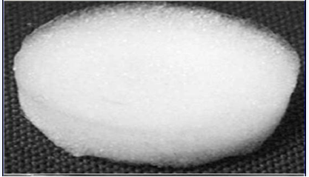
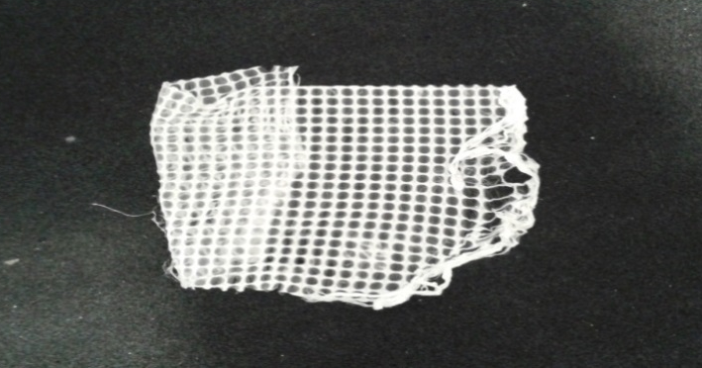
All are good answers!
Which form can have a biomaterial?
Fibers
Spheres
A lot!
Here are just some examples!
Sponge
Mesh

Slide 29
Question 8
This is a drop of gel made with collagen, a molecule you have in large amounts in your body. What do you think we can do with it?
Encapsulate neurons
Play marbles
Do false spots for halloween make up
Use it as a transparent plaster

Slide 30
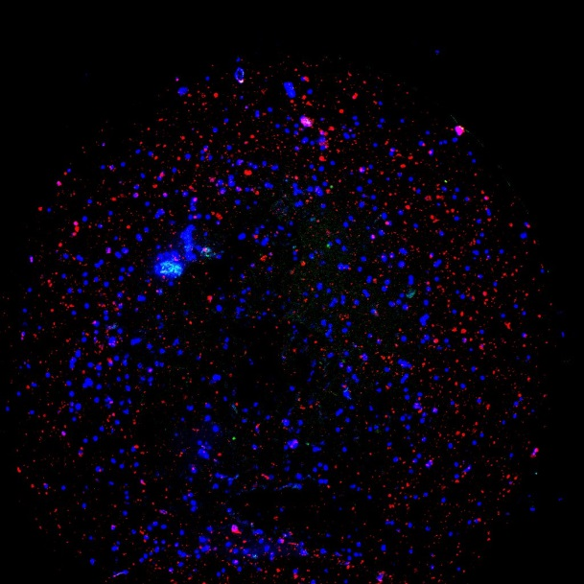
Congratulations!
This is a drop of gel made with collagen, a molecule you have in large amounts in your body. What do you think we can do with it?
Encapsulate neurons
Play marbles
Do false spots for halloween make up
Use it as a transparent plaster
It is true that some gels are used to heal cuts on your skin, but not as drops like this one. This gel is fabricated in the lab to help people suffering from Parkinson’s disease. We try to put neurons and cells in it. Blue spots are the nucleus of all the cells and red spots are neurons!

Slide 31
Ooooh…You will be better next time!
This is a drop of gel made with collagen, a molecule you have in large amounts in your body. What do you think we can do with it?
Encapsulate neurons
Play marbles
Do false spots for halloween make up
Use it as a transparent plaster
It is true that some gels are used to heal cuts on your skin, but not as drops like this one. This gel is fabricated in the lab to help people suffering from Parkinson’s disease. We try to put neurons and cells in it. Blue spots are the nucleus of all the cells and red spots are neurons!

Slide 32
Question 9
This one is a very small sphere. What do you think we can do with it?
Transform it into a cosy house for bacteria
Make very small jewels
Put a drug inside to protect it
Nothing – it’s too small!

Slide 33
Congratulations!
This one is a very small sphere. What do you think we can do with it?
Transform it into a cosy house for bacteria
Make very small jewels
Put a drug inside to protect it
Nothing – it’s too small!
When you take a drug because you are sick, it can be eliminated before arriving at the right place. These spheres can protect it and are so small that they can enter your cells and give the drug exactly where it is needed. On this new picture, the red things are cells with their nuclei colored in purple. The green spots are drugs encapsulated in the spheres. You see: many of them are in the cells!

Slide 34
Ooooh…You will be better next time!
This one is a very small sphere. What do you think we can do with it?
Transform it into a cosy house for bacteria
Make very small jewels
Put a drug inside to protect it
Nothing – it’s too small!
When you take a drug because you are sick, it can be eliminated before arriving at the right place. These spheres can protect it and are so small that they can enter your cells and give the drug exactly where it is needed. On this new picture, the red things are cells with their nuclei colored in purple. The green spots are drugs encapsulated in the spheres. You see: many of them are in the cells!

Slide 35
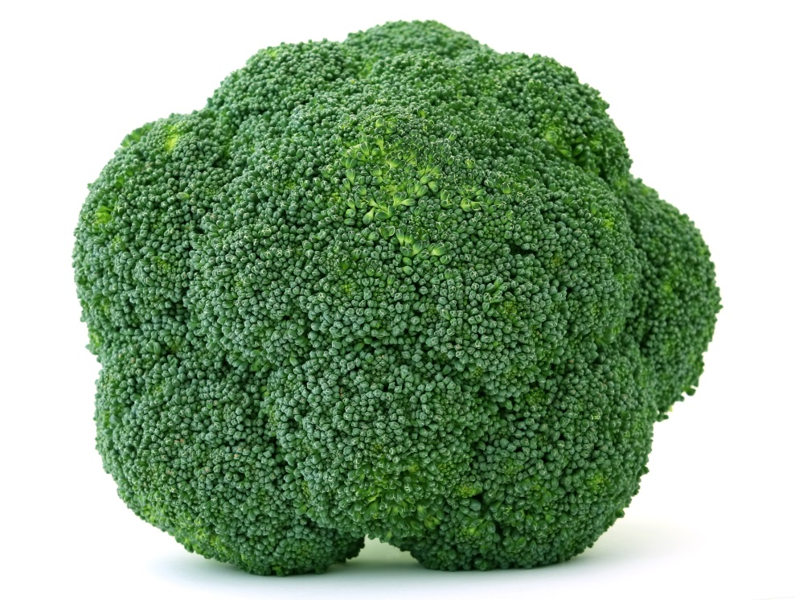
Question 10
What is this?
A broccoli
A mushroom
A cell
A particle

Slide 36
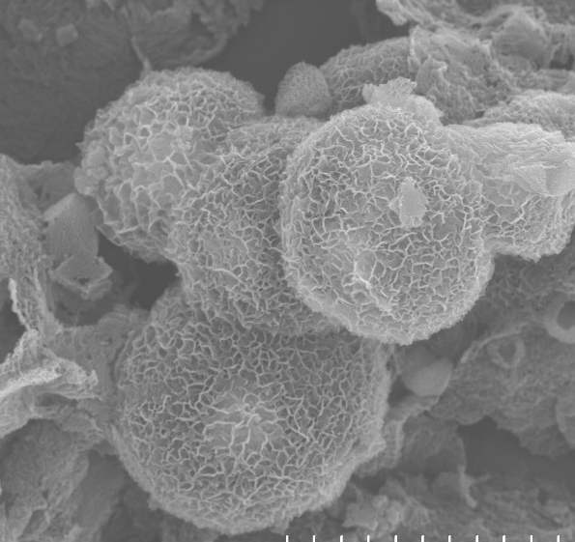
Well done!
What is this?
A broccoli
A mushroom
A cell
A particle
Particles
Cancer cell
Mushroom

Slide 37
I caught you!
What is this?
A broccoli
A mushroom
A cell
A particle
Particles
Cancer cell
Mushroom

Slide 38
That is the end of the quiz. We hope you liked it!
In the lab, we love working with these biomaterials and want them to be useful for people suffering from several diseases. Perhaps you will join us one day?

